Slide 1
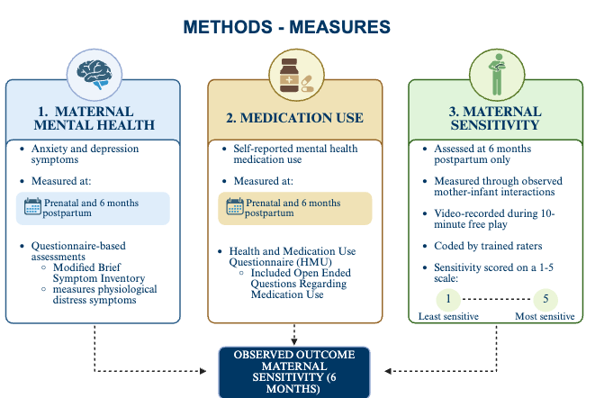
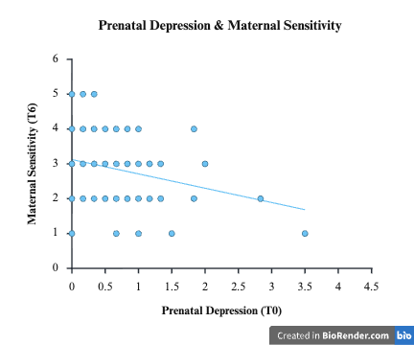
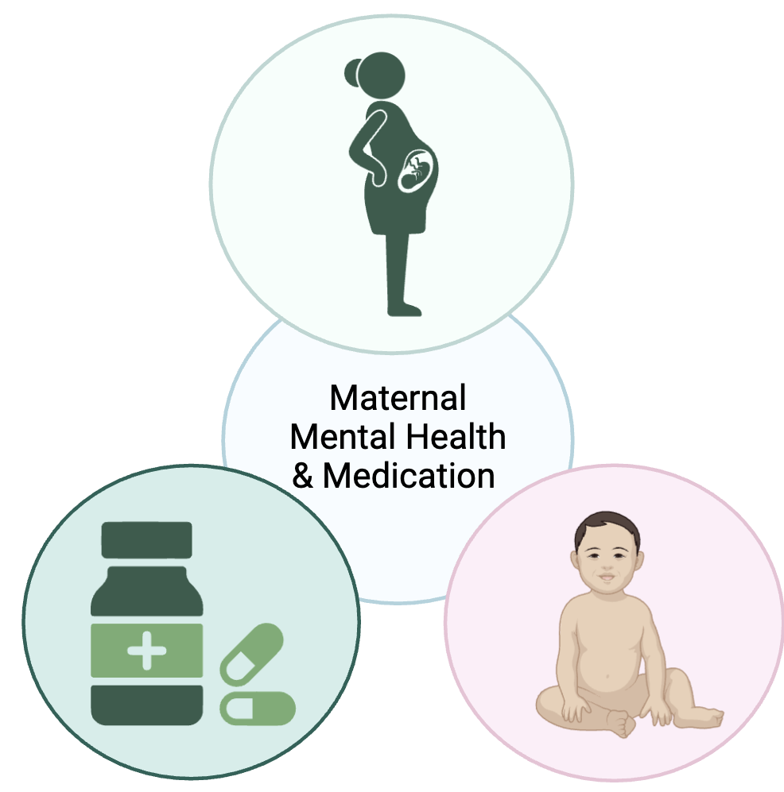
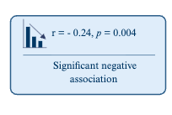
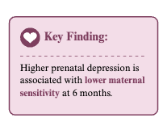
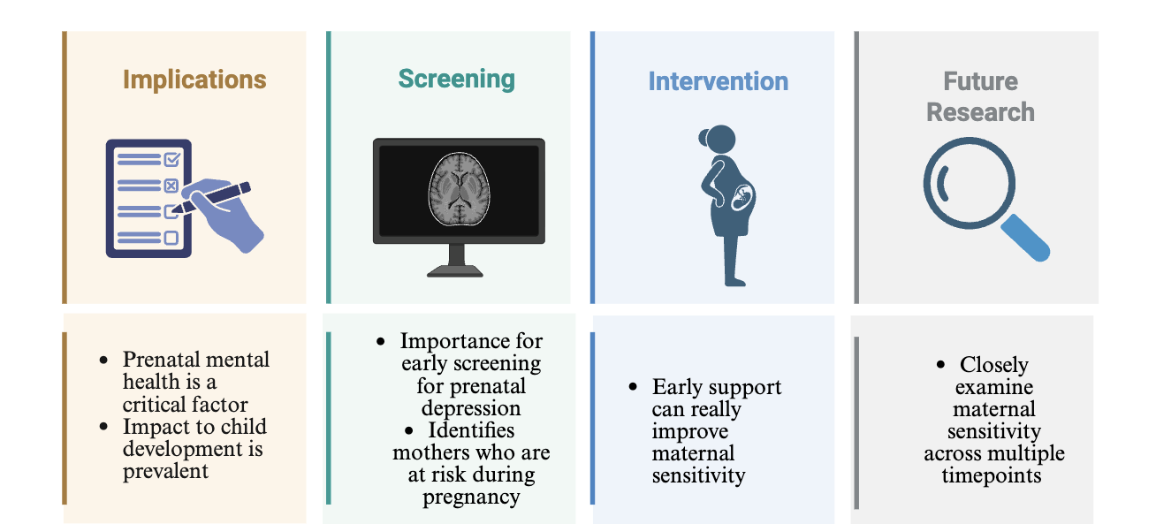
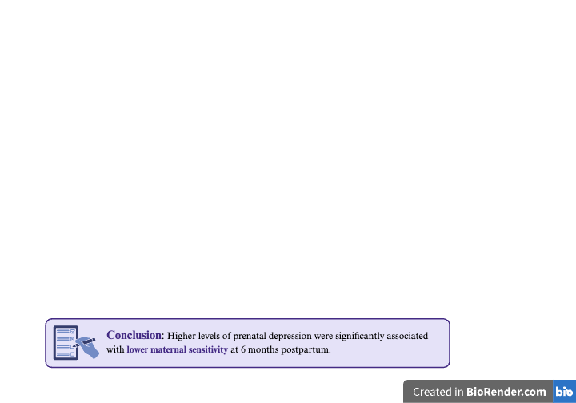
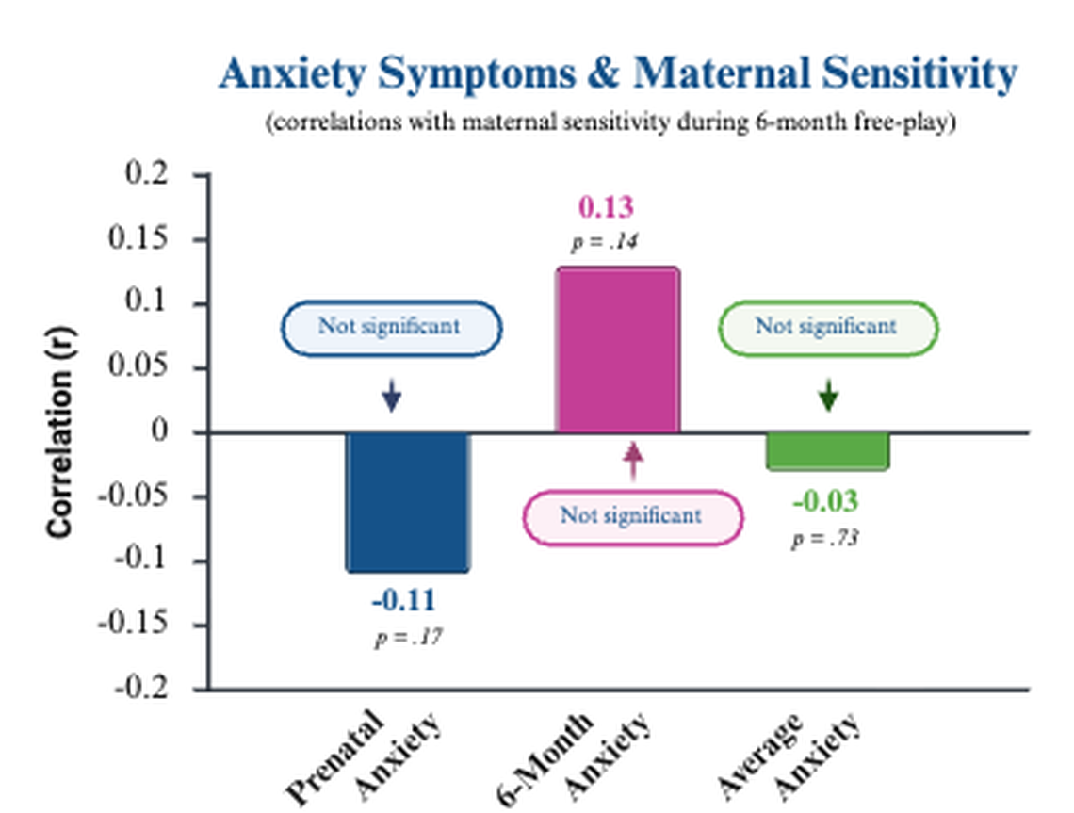
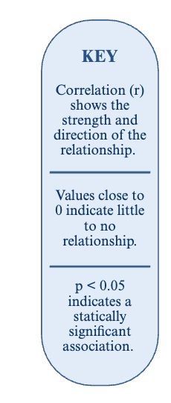
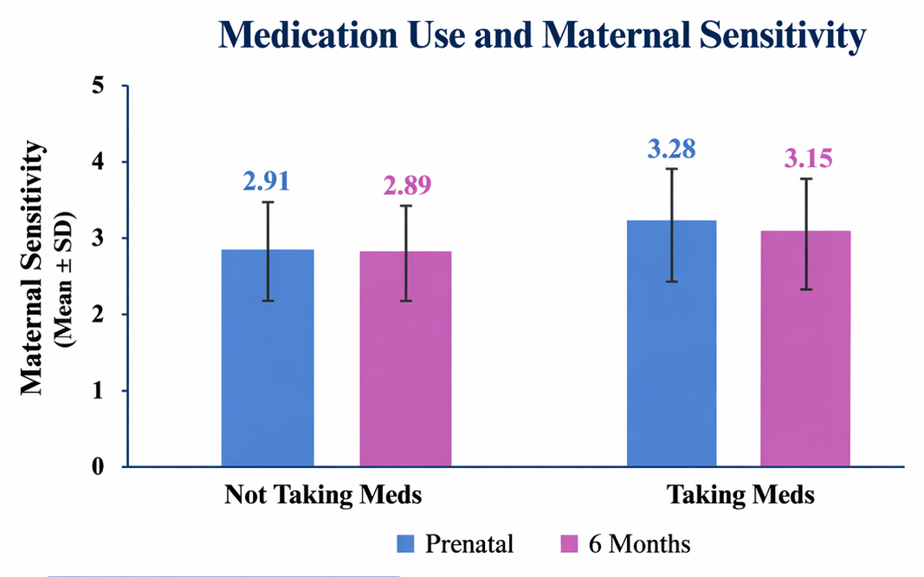
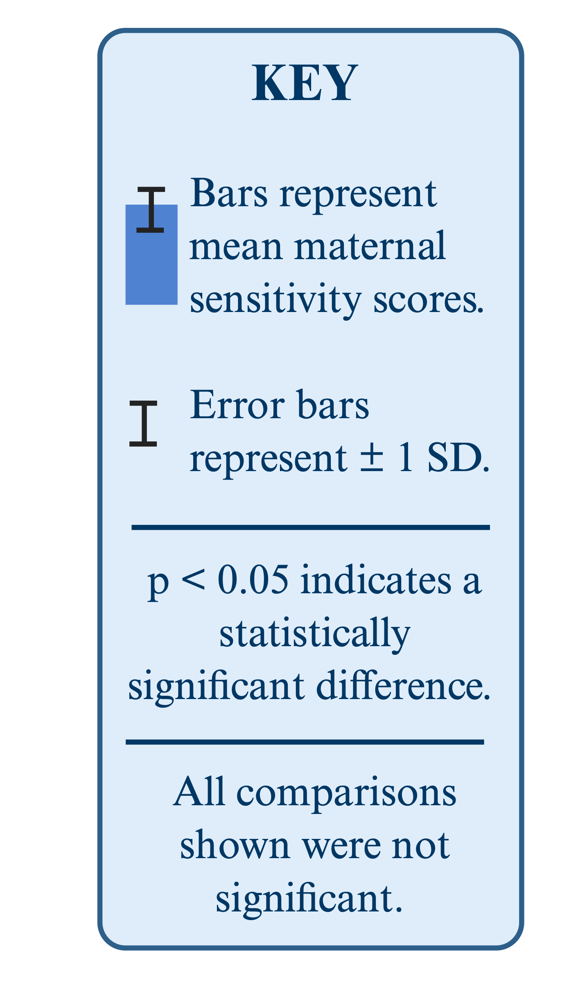


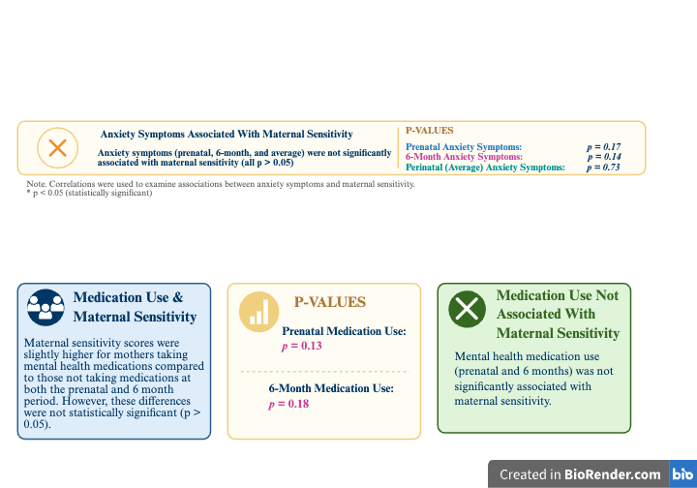
Relationships Among Maternal Mental Health, Medication Use and Parental Sensitivity.
Reem Fayyad, Grace Russell, BSN, RN & Cathi Propper, PhD
Introduction & Background
Anxiety and depression are two of the most common mental health conditions women face across their life span
The perinatal period (from pregnancy to 12 months postpartum) is a very vulnerable time due to biological and hormonal changes
During pregnancy, 1 in 5 mothers experience depression and 1 in 4 experience anxiety
Both have been linked to preterm birth, low birth weight, and altered infant development
Maternal sensitivity is key for child development and may be influenced by anxiety and depression
The effect of medication use during this time is still unclear
Limited research on medication use + sensitivity
Few students closely examine both prenatal and postpartum period
There are no studies in the literature that incorporate specific medication use and its impact on maternal sensitivity during pregnancy
Measures
Research Question 2: Is there an association between perinatal depression symptoms and maternal sensitivity when the infant is 6 months?
Research Question 3: Does maternal sensitivity when infants are 6 months differ between mothers who take mental health medication prenatally and/or postpartum and mothers who do not take mental health medications during this period?
Conclusions
Significant Findings
Prenatal depression was significantly associated with maternal sensitivity such that higher prenatal depression was related to lower maternal sensitivity at 6-months
This could mean there is something important about prenatal period that leads to longer term changes in behavior towards child (above and beyond concurrent depression, which was not associated with maternal sensitivity
Neither perinatal anxiety (prenatal and post natal anxiety) or medication use was associated with maternal sensitivity
Limitations
Self reported medication use that could be biased or inaccurate
Maternal sensitivity measured at only one timepoint
Possible COVID-19 disruptions
Purpose
To analyze the relationships among maternal mental health, medication use and maternal sensitivity during the prenatal period and at 6 months of infant age.
Implications & FUTURE DIRECTIONS
Results
Research Question 1: Is there an association between perinatal anxiety symptoms and maternal sensitivity when the infant is 6 months?
Methods
Study Design
Brain and Early Experience (BEE) Study
Examined prenatal and early childhood factors influencing infant development
Children followed from pregnancy until the age of 5
Data collected across multiple time points from mother and child
Sample
203 mother-infant dyads
Recruited through electronic medical records from UNC Hospitals, WIC centers, Instagram and Facebook advertisements
Inclusion Criteria
Mothers age of 18 years or older
Spoke English at home
Dyad must be more after 36.5 weeks gestation and weighed more than 5 pounds at birth
Healthy births
Resided close to Chapel Hill during pregnancy (approx. 45 minutes)
Acknowledgement
The Brain and Early Experience study is funded by the National Institute of Child Health and Human Development (grant R01 HD091148; PIs: Cathi Propper & Sarah Short)
References
The UNC Brain
and Early
Experience Lab
Notes:
Non-Significant Findings
Perinatal anxiety was not associated with maternal sensitivity
Free play can be a low-stress environment preventing the enhancement of anxiety-related behaviors
Maternal symptoms might be less stable through time
Depression at 6-months was not associated with maternal sensitivity
Medication use was not associated with maternal sensitivity

