Slide 1
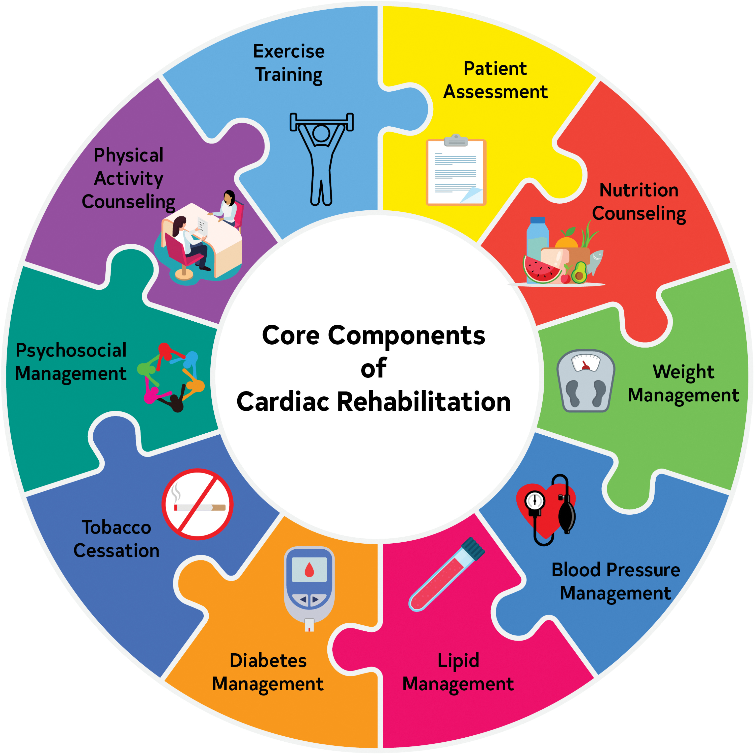
Maintenance of Cardioprotective Behaviors After Phase II Cardiac Rehabilitation Graduation:
A Program Evaluation
Kayla Roberts, BSN, rn, ccrn; Leslie davis, phd, ANP-BC; tracy Vernon-platt, dnp, anp-bc; mary ann Compton, MA, CCRP
INTRODUCTION
Table 1: Participant Cardiac Rehabilitation Dose & Program Start Times (n=10)
 | Days from Hospital Discharge to Intake Visit | Days from Referral to Intake Visit | Days from Intake Visit to 1st Billable Session | Days from Referral to 1st Billable Session | Total Sessions Completed
M (SD) | 42.9 (28.7) | 20 (14.3) | 14.3 (12.1) | 34.3 (18.0) | 32.8 (3.8)
Median | 40 | 22 | 9.5 | 29.5 | 34
RESULTS
Cardiovascular disease (CVD) has been the leading global cause of morbidity and mortality since 1921.¹
Unhealthy diet and physical inactivity, two of the top five major modifiable CVD risk factors, accounted for ~9 million annual deaths from 2019–2021.^{2, 3, 4}
Cardiac Rehabilitation (CR) is a class IA recommendation by the American Heart Association/American College of Cardiology (AHA/ACC) for secondary prevention, reducing mortality by up to 25% (i.e., for patients with a history of percutaneous coronary intervention [PCI] or coronary artery bypass graft [CABG]).⁵
Patients with history of myocardial infarction (MI), chronic stable angina, chronic heart failure with reduced ejection fraction, PCI, CABG, heart valve replacement or heart or heart-lung transplant are recommended to attend all 36 sessions of a phase II CR program. ^{6, 7}
Despite benefits of reductions in major adverse cardiac events (MACE), patients who attend CR, often fail to adhere (i.e., attend recommended number of sessions) and/or maintain long-term cardioprotective behaviors post-graduation.⁸
Crosswalk findings:
Project site in full alignment with 8/12 (67%) of required core components as defined by AHA & AACVPR (Nutritional counseling, Weight management and body composition, Dyslipidemia management, Diabetes management, Psychosocial management, Aerobic exercise training, Physical activity counseling, and Program Quality). The remaining 4 core components were partially aligned.
Project site in full alignment with AHA Life’s Essential 8
Variable declines in exercise maintenance across CR dose (i.e., attendance level) for the 10 CR patients interviewed
Findings from patient interviews (n=10)
Dietary behavior maintenance largely preserved across CR dose (see Table 2)
Patients with full adherence expressed readiness to maintain cardioprotective behaviors was attributed to repeated session exposure.
Poor readiness to transition was attributed to informal discharge planning or exit interview by some of the 10 participants
Key Themes – Facilitators: Higher CR dose, physiologic improvements, strong mental health, established off-day routines, strong social support, accountability and structure
Key Themes – Barriers: Competing obligations, delayed program start, lack of social support, mental health challenges, access, finances, loss of structure and external accountability
PURPOSE
To examine the effectiveness of existing interventions at a single outpatient CR facility in promoting adherence and long-term maintenance of cardioprotective behaviors (i.e., exercise and diet)
To identify facilitators and barriers in adherence and maintenance
To assess alignment between evidence-based standards outlined in the 2024 AHA/American Association of Cardiovascular & Pulmonary Rehabilitation (AACVPR) Core Components of Cardiac Rehabilitation Programs and those observed during project implementation, to inform recommendations for opportunities for improvement
CONCLUSIONS/IMPLICATIONS
Higher CR dose increases confidence, but does not eliminate reduced maintenance
Regardless of dose, patients reported similar facilitators and barriers
Project site provided with 8 recommendations highlighting opportunities for improvement.
METHODS
  Study Design
  Retrospective chart review from electronic health record (i.e., Epic)
  Semi-structured interviews with CR patients and staff (i.e., via Zoom or In-person)
  Field notes from observation of intake and exit interviews, CR class, nutrition class and/or consult, graded exercise stress test, and online education modules
  Sample
  Inclusion criteria: patients > 18 years enrolled into CR with CVD
  *Note: Inclusion criteria was expanded mid–implementation (i.e., initial criteria only included patients with a diagnosis of MI)
Table 2: 30 Day Behavior Maintenance by Cardiac Rehabilitation Dose
Attendance Level | Behavior | Full (n) | Partial (n) | None (n) | Total Patients
High (36 sessions) (n=5) | Exercise | 3 | 1 | 1 | 5
 | Dietary | 5 | 0 | 0 | 5
Moderate–High (24–35 sessions) (n=5) | Exercise | 0 | 3 | 2 | 5
 | Dietary | 4 | 1 | 0 | 5
REFERENCES
¹Palaniappan, L. P., Allen, N. B., Almarzooq, Z. I., Anderson, C. A. M., Arora, P., Avery, C. L., Baker-Smith, C. M., Bansal, N., Currie, M. E., Earlie, R. S., Fan, W., Fetterman, J. L., Barone Gibbs, B., Heard, D. G., Hiremath, S., Hong, H., Hyacinth, H. I., Ibeh, C., Jiang, T., Johansen, M. C., … American Heart Association Council on Epidemiology and Prevention Statistics Committee and Stroke Statistics Committee (2026). 2026 Heart disease and stroke statistics: A report of US and global data from the American Heart Association. Circulation, 10.1161/CIR.0000000000001412. Advance online publication. https://doi.org/10.1161/CIR.0000000000001412
²Antipolis, S. (2020). Poor diet is top contributor to heart disease deaths globally. European Society of Cardiology. https://www.escardio.org/The-ESC/Press-Office/Press-releases/poor-diet-is-top-contributor-to-heart-disease-deaths-globally
³Tian, D., & Meng, J. (2019). Exercise for prevention and relief of cardiovascular disease: Prognoses, mechanisms, and approaches. Oxidative Medicine and Cellular Longevity, 2019, 3756750. https://doi.org/10.1155/2019/3756750
⁴Vaduganathan, M., Mensah, G. A., Turco, J. V., Fuster, V., & Roth, G. A. (2022). The global burden of cardiovascular diseases and risk: A compass for future health. Journal of the American College of Cardiology, 80(25), 2361–2371. https://doi.org/10.1016/j.jacc.2022.11.005
⁵Thomas, R. J. (2024). Cardiac rehabilitation — challenges, advances, and the road ahead. The New England Journal of Medicine, 390(9), 830-841. https://doi.org/10.1056/NEJMra2302291
⁶Bracewell, N. J., Plasschaert, J., Conti, C. R., Keeley, E. C., & Conti, J. B. (2022). Cardiac rehabilitation: Effective yet underutilized in patients with cardiovascular disease. Clinical Cardiology, 45(11), 1128–1134. https://doi.org/10.1002/clc.23911
⁷Rao, S. V., O'Donoghue, M. L., Ruel, M., Rab, T., Tamis-Holland, J. E., Alexander, J. H., Baber, U., Baker, H., Cohen, M. G., Cruz-Ruiz, M., Davis, L. L., de Lemos, J. A., DeWald, T. A., Elgendy, I. Y., Feldman, D. N., Goyal, A., Isiadinso, I., Menon, V., Morrow, D. A., Mukherjee, D., … Williams, M. S. (2025). 2025 ACC/AHA/ACEP/NAEMSP/SCAI guideline for the management of patients with acute coronary syndromes: A report of the American College of Cardiology/American Heart Association Joint Committee on clinical practice guidelines. Circulation, 10.1161/CIR.0000000000001309. Advance online publication. https://doi.org/10.1161/CIR.0000000000001309
⁸Evenson, K.R., Ridenour, T.A., Bagwell, J., Furberg, R. D. (2021). Sustaining physical activity following cardiac rehabilitation discharge. Research Triangle Park (NC): RTI Press. https://www.ncbi.nlm.nih.gov/books/NBK570656/
This project was funded by the Alpha Alpha Chapter of Sigma Theta Tau International Honor Society of Nursing
Notes:
4x3 aspect ratio poster File size is 28” w x 21” h

