Slide 1
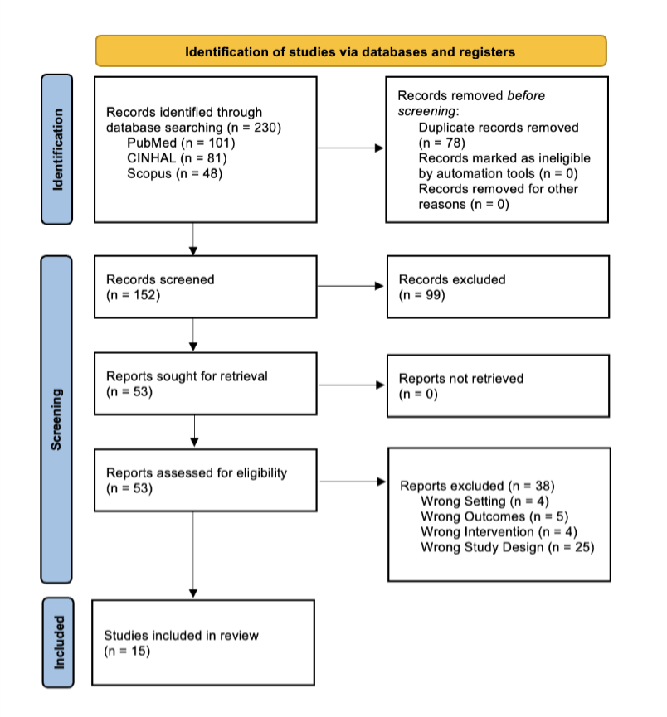

Midwifery Care in Rural Settings in the United States: A Scoping Review
Jewel Benton, BSN Candidate & Rhonda K Lanning, DNP, CNM, IBCLC, LCCE, FACNM, RN
Introduction
Maternal mortality rates in the United States are 2-3 times higher than in other high-income countries, with rural populations experiencing higher morbidity rates due to social drivers of health, maternity care deserts, and rural hospital closures (Bozkurt et al., 2025; Gunja et al., 2024).
Midwifery care is a holistic approach associated with reduced interventions, positive birthing experiences, and cost savings compared with obstetric care (National Association of Certified Professional Midwives, 2024a; The American College of Nurse Midwives, 2025c).
While several studies have explored the benefits of midwifery care compared to other maternity care models within urban areas of the U.S. and other countries around the world (Sandall et al., 2024; Tietjen et al., 2021; Nasiri et al., 2025), none of these studies include the outcomes and accessibility of midwifery care in rural populations across the United States.
Methods and Data Extraction
Midwifery Availability and Workforce​​
Rural hospitals have limited access to lactation support, doula care, postpartum support classes, and childbirth education classes (Basile Ibrahim et al., 2022).​​
Many hospitals desire midwifery services, with 88% planning to hire in the future (Kozhimannil et al., 2016b).
Structural Inequities and Systemic Barriers
Rural counties with a higher proportion of BIPOC residents and Medicaid-funded births had significantly less access to midwifery care (Basile Ibrahim et al., 2022; Sheffield et al., 2024).
Patient Experience and Holistic Care
Clients valued a personal relationship with their midwives, reporting greater trust and confidence, and they preferred providers who recognized potential problems and put safeguards in place rather than those who were simply licensed (Neerland & Skalisky, 2022; Ward et al.,2025).
Purpose
This scoping review examines how the midwifery model of care compares with physician-led obstetric care in impacting clinical outcomes, access to care, and patient-reported experiences during pregnancy and childbirth for childbearing people in rural settings within the United States.
Gaps in research
None of the studies examined maternal outcomes of rural communities that do not have access to a hospital with a labor and delivery unit.​
Future studies may also explore the patient’s decision-making process when selecting a maternity care provider and desire for midwifery care. ​
Additional research should examine the subjective experiences of patients in rural areas seeking prenatal care, including birth setting preference, perception of emotional support, and experiences with postpartum care.
Future research should compare CNMs, CMs, CPMs, and Lay Midwives to understand availability, birthing outcomes, and experience in rural settings.
RESULTS and Summary of FINDINGS
Quantitative (retrospective cohort, case-control, cross-sectional, observational cohort, secondary analysis), mixed-methods, qualitative descriptive, and one integrative review.
All studies took place in the United States. Studies focused on rural populations, including settings such as rural hospitals or birth centers, statewide or national databases, and one specific rural religious community. ​
Conclusion
References
Clinical Outcomes and Intervention Rates
Midwifery care results in outcomes that are as favorable or more favorable than those of obstetric care, with fewer interventions (Damiano et al., 2020; Hamlin, 2017; Lundsberg et al., 2020).
While midwifery care in rural populations faces limitations in availability and workforce, it is associated with comparable or improved outcomes, fewer interventions, and greater patient satisfaction.
Increasing midwifery access in rural areas may enhance patient experience and reduce systemic inequities.
Geographical and Logistical Barriers to Care​
Most frequently identified barrier to accessing prenatal care in rural populations is transportation, resulting in longer travel times, difficulty finding a provider who offers the desired care, less prenatal education, and higher rates of delayed prenatal care (Durfee et al., 2025).​
Image source: Adobe Stock
Notes:
72”w x 42”h poster (PhD Posters-$64.95) Sized for SON 6ft Roll Displays. File size is 36” w x 21” h, (IMPORTANT note for PhD Posters upon submission of poster) print at 200%; Trim leaving a white 1/2” edge around all sides of poster

