Slide 1
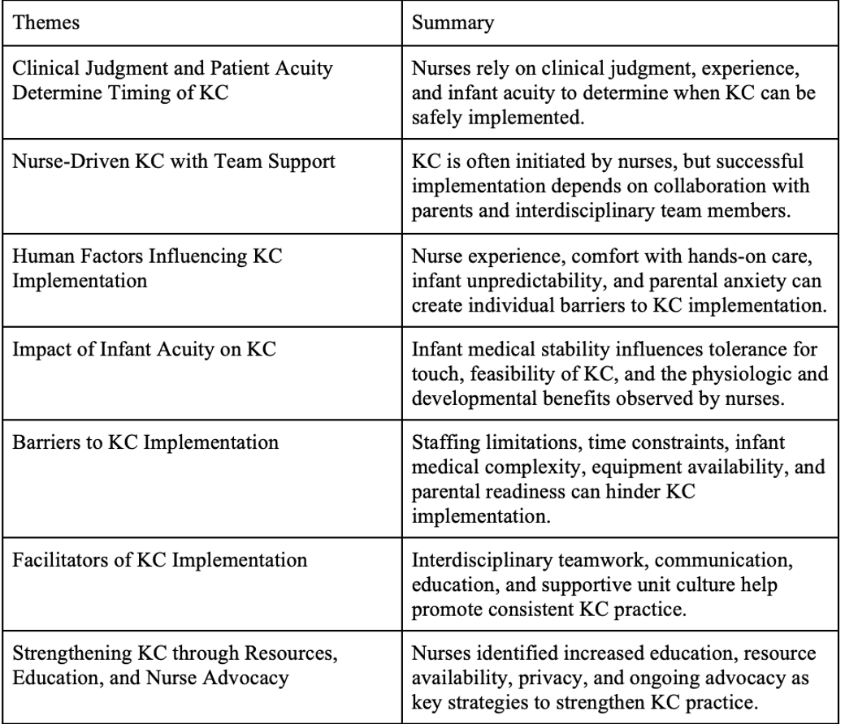

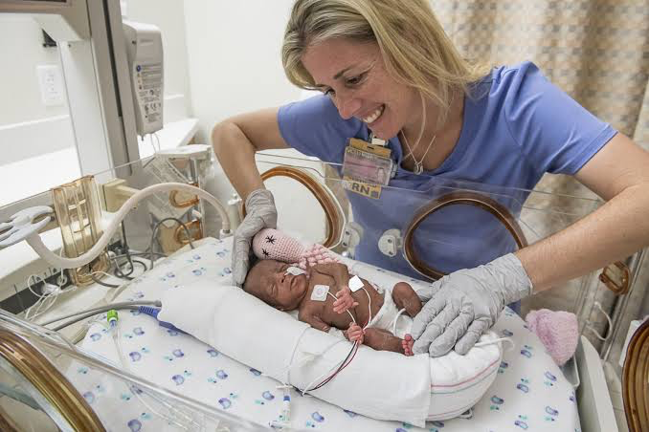
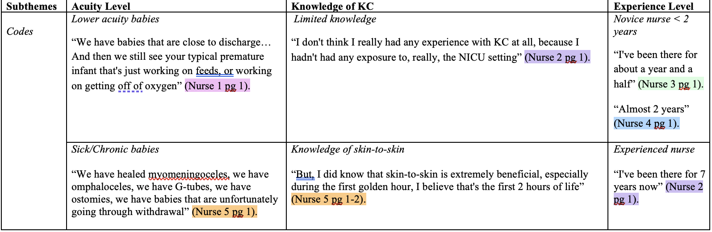
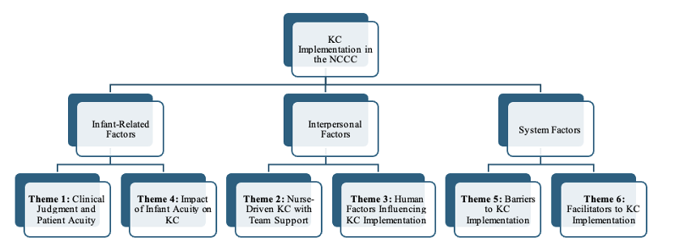

Neonatal Critical Care Nurses’ Experiences with KC for Premature Infants: A Qualitative Study
Kelsi Carmody, Student Nurse; Megan Williams, EdD, MSN, RN, FNP, CNE
The University of North Carolina at Chapel Hill, School of Nursing
,
  Introduction
  Results
  Conclusion
Preterm birth is when an infant is born before 37 weeks of pregnancy. In the United States in 2022, 1 in 10 were born preterm. Although fetal development occurs over the entire course of pregnancy, the final weeks are critical as this is where maturation of major organs like the brain, lungs, and liver takes place. (Centers for Disease Control and Prevention, 2024).
At the highest level of care, Level IV neonatal intensive care units (NICUs), such as Newborn Critical Care Centers (NCCCs), manage critically ill infants regardless of birth weight and gestational age.
In the NCCC, preterm infants are frequently exposed to stressors such as bright lights, noise from medical equipment, and invasive hospital procedures. Developmental care strategies, such as family-centered care models and integrative interventions, aim to reduce these stressors while promoting neuroprotection and parental involvement.
Kangaroo Care (KC) is an evidence-based intervention defined by the World Health Organization as early, ongoing, and persistent skin-to-skin contact between the infant and parent, and can even be done with breastfeeding (WHO, 2023). This intervention offers tactile, kinesthetic, olfactory, and motor stimulation, while fostering attachment and bonding which are critical for the infant’s emotional and social development.
The purpose of this study is to explore the firsthand experiences of nurses in the NCCC who have at least 1 year of experience implementing KC on the unit and identify the factors that facilitate or hinder its use and to understand what nurses observe when it is practiced with preterm infants and their families.
Findings illustrate KC as an evidence-based practice that is shaped by nurse-driven advocacy and clinical judgment, infant acuity, interdisciplinary teamwork, and numerous barriers like staffing limitations and time constraints.
Overall, these findings highlight the pivotal role nurses play in initiating and supporting KC, calling attention to the value of continuing education, interdisciplinary collaboration, and supportive unit cultures to promote safe and consistent KC practice in NCCCs.
Ultimately, advocating for KC not only promotes physiologic stability for premature infants but also strengthens the meaningful connection between parents and their newborns, a time that is truly purposeful and resilient, and nurses are proud to be the voice for the smallest and most vulnerable patients.
  METHODS
  Study Design
  A qualitative exploratory study was conducted through five semi-structured interviews with an interview guide.
  Sample
  Participants were required to be registered nurses working in the NCCC, have at least one year of unit experience, and be able to participate in an English-language interview.
  Data Analysis
Interview transcripts were analyzed using inductive thematic analysis following the six-phase framework described by Braun and Clarke (Braun & Clarke, 2006). The identified codes and themes were discussed with the faculty advisor prior to writing the results section. A summary of the main codes and themes was added to the codebook.
The study was approved by the University of North Carolina at Chapel Hill Institutional Review Board and the UNC Health Nursing Research Council.
  Implications
Continuing education for nurses and families can help improve KC facilitation.
Education on safe positioning, assessing infant stability, and developmental care practices may help nurses feel more confident when facilitating KC.
This study also highlights the importance of examining nurses’ perspectives when exploring KC implementation in neonatal critical care environments.
Future research should continue to explore nurses’ perspectives on KC implementation in high-acuity neonatal settings to deepen understanding of the infant-related, interpersonal, and system factors that influence this practice.
Table 1. Key Themes from Interviews with NCCC Nurses on KC
  References
Reference list:
All images retrieved from Google Images
  Acknowledgements
This project was supported by the Sarah Steele Danhoff Undergraduate Research Fund administered by Honors Carolina. I would like to thank the NCCC leadership and nursing staff for their support, guidance, and the opportunity to learn from their practice.
Codebook Section 1: Background / Context
Figure 1. Thematic Map of Factors Influencing KC Implementation in the NCCC
Notes:
72”w x 42”h poster (PhD Posters-$64.95) Sized for SON 6ft Roll Displays. File size is 36” w x 21” h, (IMPORTANT note for PhD Posters upon submission of poster) print at 200%; Trim leaving a white 1/2” edge around all sides of poster

