Slide 1
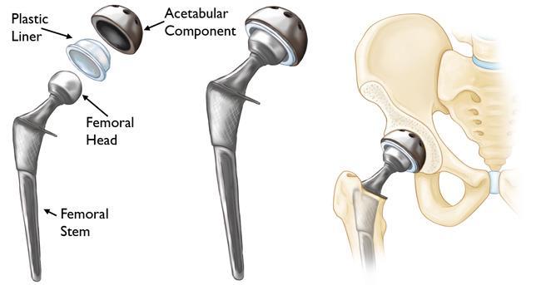
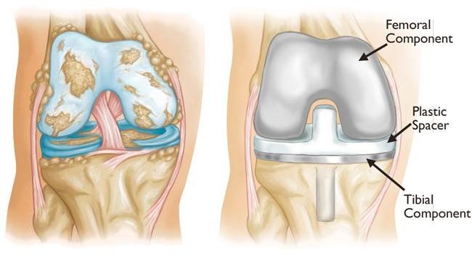
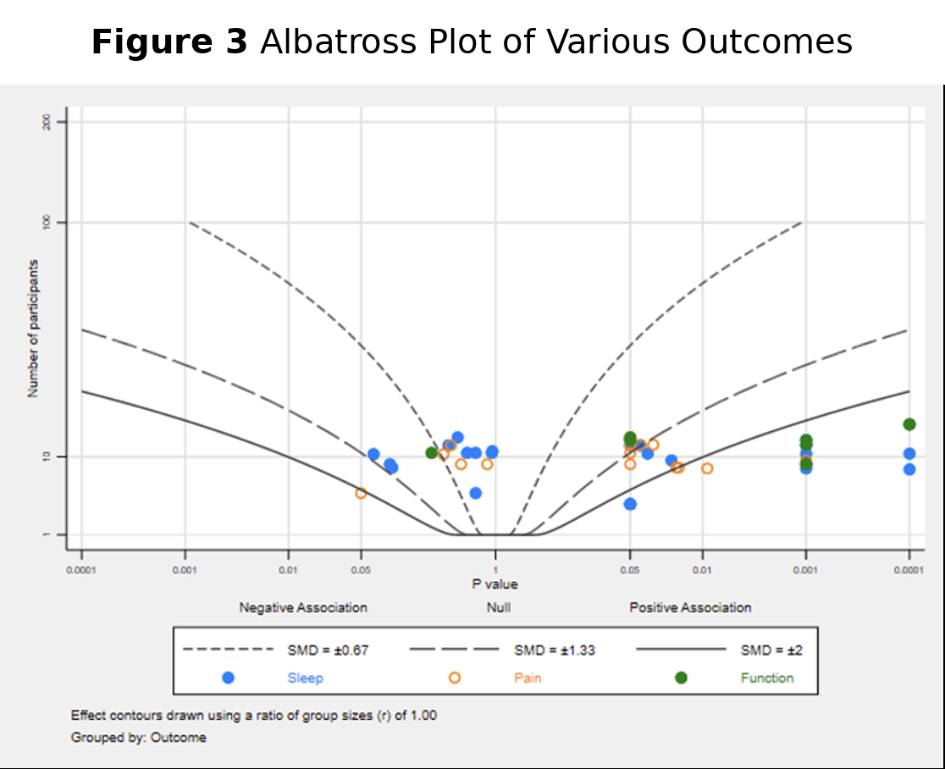
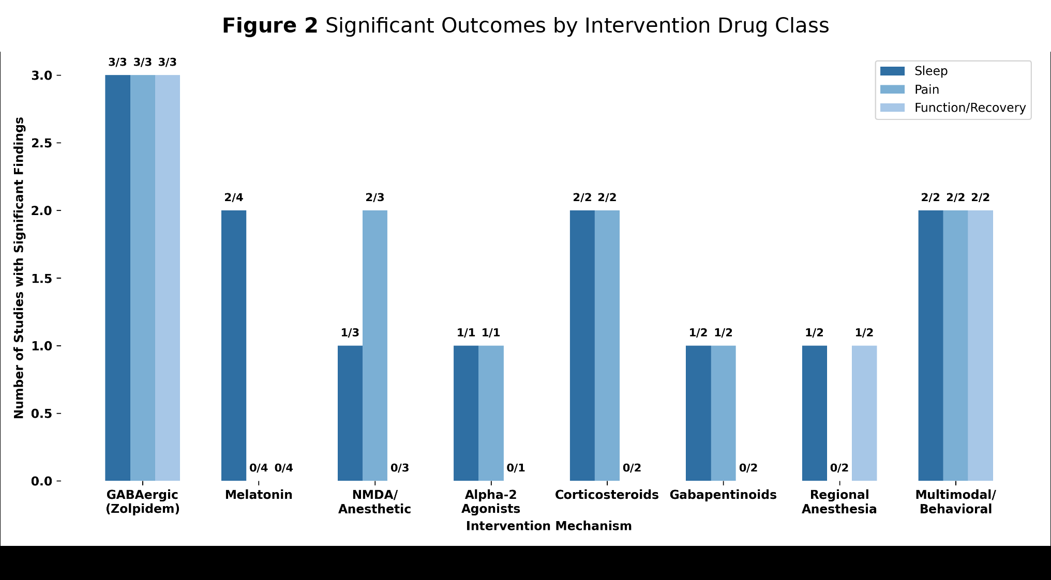
The Nurse’s Evaluation of the Impact of Sleep Optimization Protocols on Post-Surgical Outcomes in Total Arthroplasty Patients:
A Systematic Review
Natalie Landeros, Student Nurse; Megan Williams, EdD, MSN, RN, FNP, CNE
Background
Patients undergoing total hip arthroplasty (THA) or total knee arthroplasty (TKA) surgery often face frequent sleep disruptions at night.
Enhanced sleep with this demographic is correlated with pain, overall recovery, rehabilitation performance, symptoms of depression (Baranwal et al., 2023; Getachew et al., 2021; Rampes et al., 2020).
As nurses are primarily at the bedside monitoring patients, there remains a gap in evidence-based nursing approach to intervene with sleep protocols to address pain and functional recovery of these patients.
Conclusions
Sleep optimization interventions are correlated with improved postoperative pain and functional recovery outcomes in THA/TKA patients.
Specific pharmacological interventions paired with a multimodal approach showed the most consistent benefit.
Nurses play a key role in monitoring the amount of sleep quality for patients and coordinating factors that encourage sleep.
Nurses may enhance sleep quality, pain, and functional recovery in administering or performing these pharmacological and multimodal interventions.
Results
Note. From American Academy of Orthopaedic Surgeons (n.d.)
Note. From American Academy of Orthopaedic Surgeons (n.d.)
Of the 18 included studies, 1,978 participants were enrolled in the studies using a variety of pharmacological interventions to measure sleep, and some studies measuring pain, and functional recovery. Significant findings were clustered around moderate-to-large effect size for all three outcomes (Figure 3).
Sleep outcomes. Medications like zolpidem (GABAergic), dexmedetomidine (alpha-2 agonist), and corticosteroids were shown to have significant improvements on sleep quality for both TKA and THA. Melatonin had varying effects on sleep quality, especially in longer term studies.
Pain outcomes. Of the 15/18 studies that measured pain, the most significant outcomes were shown in the early to mid postoperative period and were stronger with both pharmacologic and multimodal intervention
Functional outcomes. There were limited studies that examined functional outcomes that involved sleep interventions. The 7/18 studies demonstrated functional improvement through various interventions often alongside sleep and pain (Figure 2).
Purpose
The purpose of this study is to explore what interventions are used to assess sleep, pain, and functional outcomes for TKA and THA procedures within the United States and other countries to better understand the nursing role in improving outcomes.
Methods
Study Design
Systematic review of 18 randomized control trials following PRISMA guidelines
Search strategy
Four databases
were used to find studies
within the last 10 years
Inclusion criteria
English RCTs
Adults undergoing
TKA/THA surgery
Sleep interventions
United States and
other countries
Study selection
Screened using
Covidence
3 reviewers; conflicts
resolved by third
reviewer
Figure 1. PRISMA diagram.
Identification of studies via databases and registers
Studies identified from*:
Databases (n = 709)
305 Cochrane
215 Scopus
137 PubMed
52 CINAHL
Studies removed before screening:
Duplicate records removed (n = 291)
Records marked as ineligible by automation tools (n = 0)
Records removed for other reasons (n = 0)
Future Implications
Further research that measures sleep-oriented interventions can be used to inform evidence-based nursing interventions for patients undergoing TKA/THA.
More research is needed to assess the relationship between sleep, pain and functional recovery and the postop timing of interventions used.
Identification
Studies screened
(n = 417)
Studies excluded**
(n = 372)
Screening
Studies excluded: 23
Wrong study design (n = 11)
Wrong intervention (n = 6)
Unable to obtain full text (n = 4)
Non-English study (n = 1)
Wrong outcomes (n = 1)
Studies assessed for eligibility
(n = 41)
References
Studies included in review
(n = 18)
Baranwal, N., Yu, P. K., & Siegel, N. S. (2023). Sleep physiology, pathophysiology, and sleep hygiene. Progress in Cardiovascular Diseases, 77, 59–69.
Getachew, M., Lerdal, A., Småstuen, M. C., Gay, C. L., Aamodt, A., Tesfaye, M., & Lindberg, M. F. (2021). High levels of preoperative pain and fatigue are red flags for moderate-severe pain 12 months after total knee arthroplasty-A longitudinal cohort study. Musculoskeletal Care, 19(2), 186–192. https://doi.org/10.1002/msc.1522
Rampes, S., Ma, K., Divecha, Y. A., Alam, A., & Ma, D. (2020). Postoperative sleep disorders and their potential impacts on surgical outcomes. Journal of Biomedical Research, 34(4), 271–280. https://doi.org/10.7555/JBR.33.20190054
American Academy of Orthopaedic Surgeons. (n.d.). Revision total knee replacement. https://orthoinfo.aaos.org/en/treatment/revision-total-knee-replacement/
American Academy of Orthopaedic Surgeons. (n.d.). Total hip replacement. Total hip replacement
Included

