Slide 1
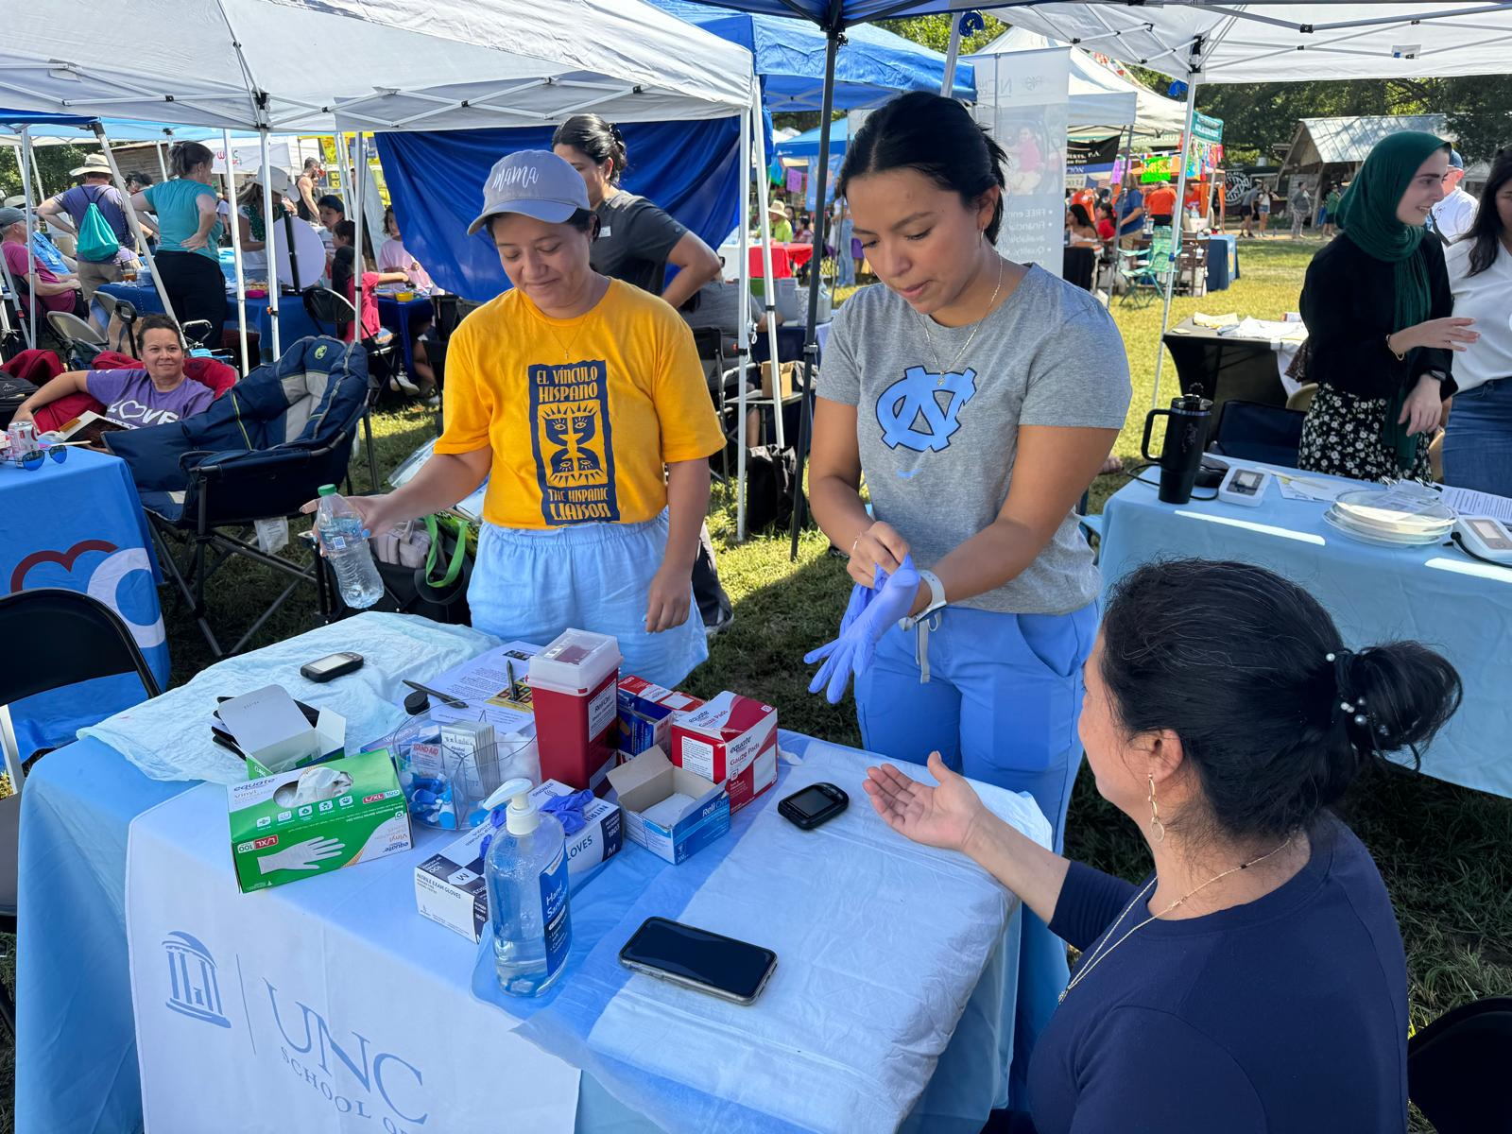
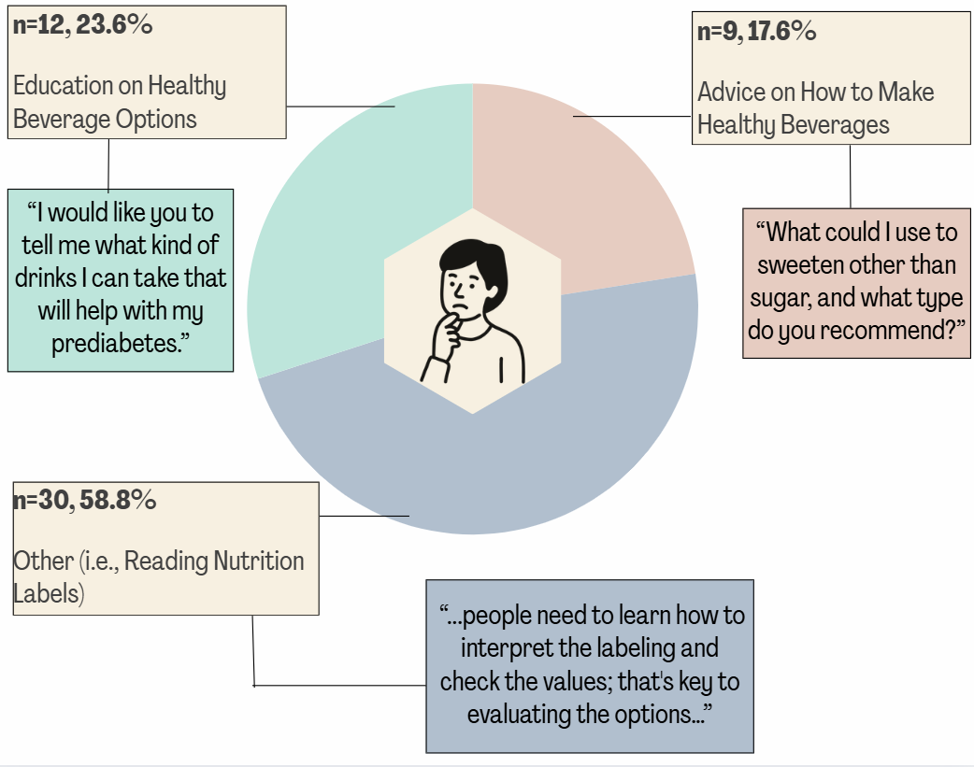
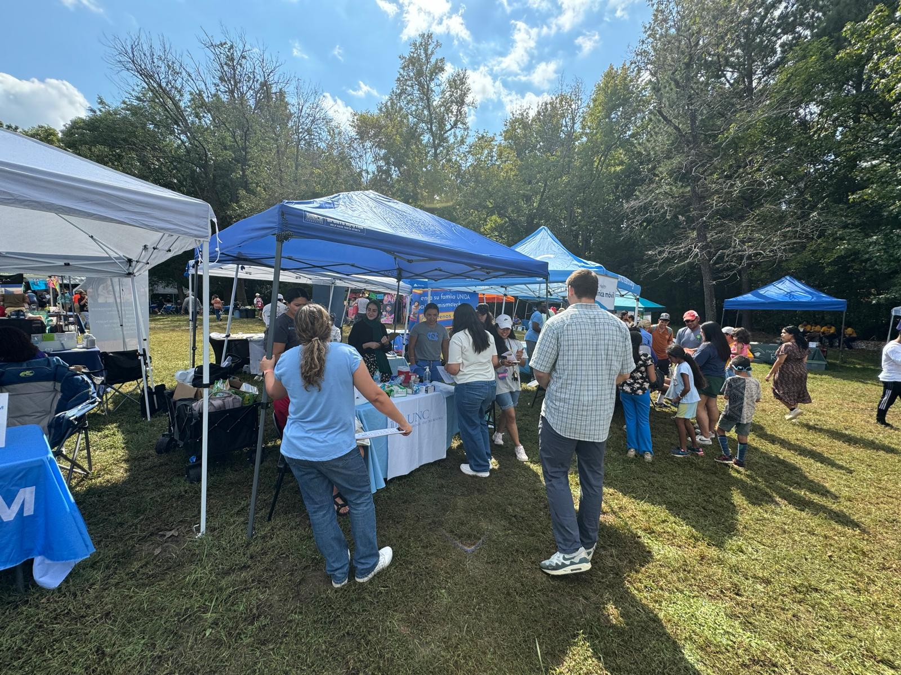
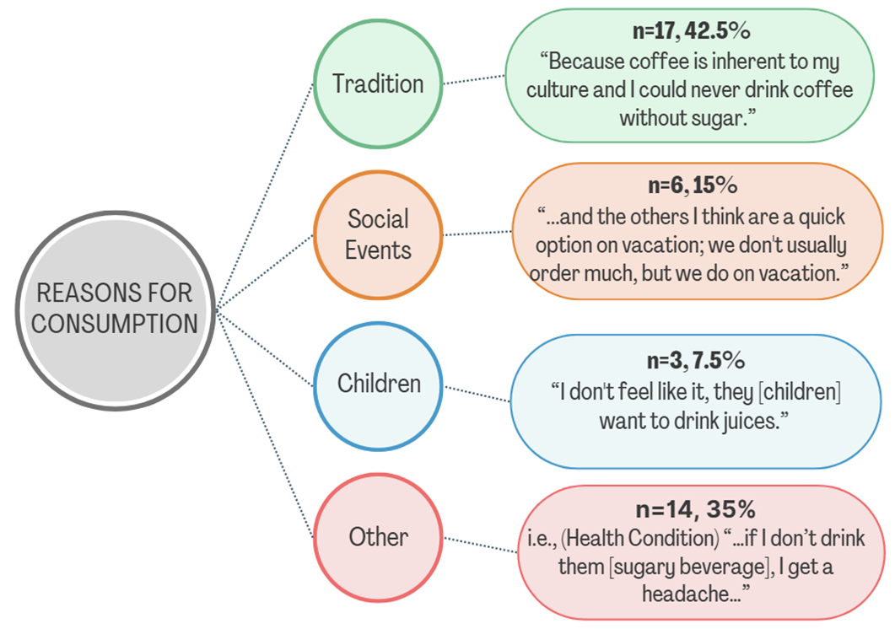
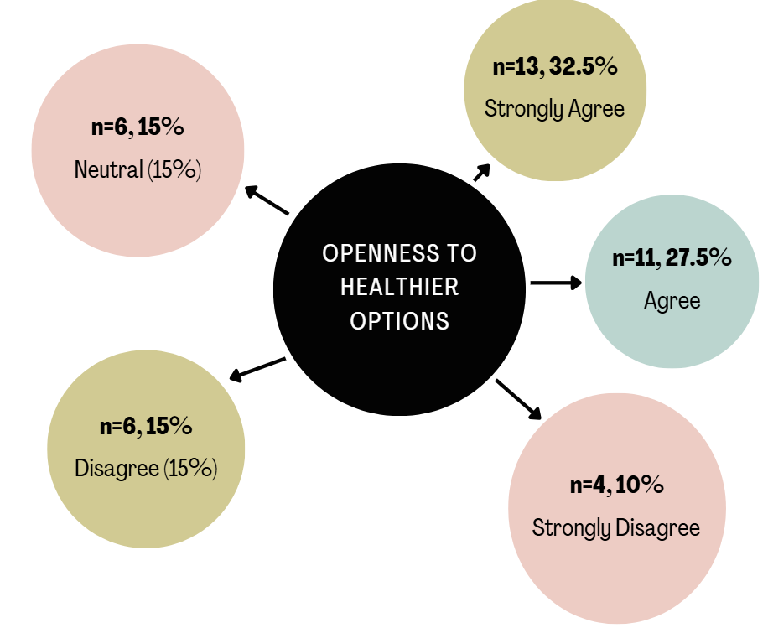
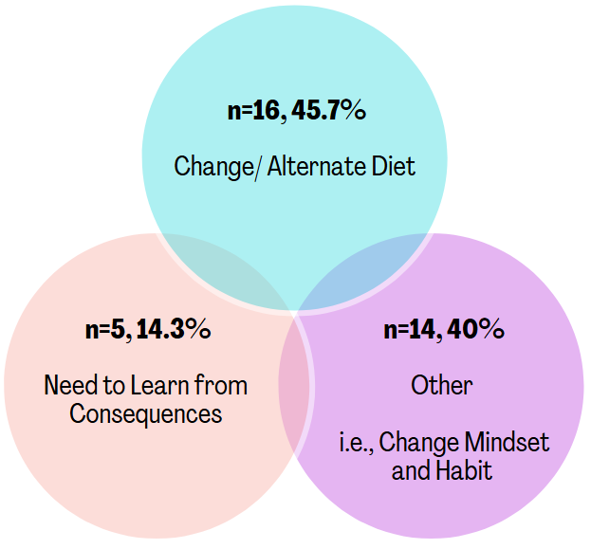
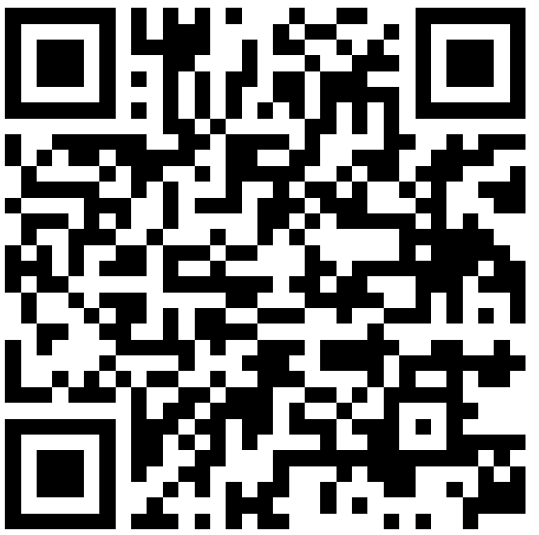
The Silent Epidemic: Sugary Beverages and the Rise of Chronic Disease in Hispanic Populations
Jailene Lemus Hurtado (BSN ’26), Natalia Villegas Rodriguez, PhD, MSN, RN, IBCLC, FAAN (Advisor)
Background
  Results
IMPLICATIONS
  Sugar-sweetened beverage’s (SSBs) remain common in many households and are often the preferred drink for children and adults. This pattern places families at higher long-term health risks and increases preventable healthcare burden.¹
  While it is known that SSB is strongly linked to metabolic syndromes, there are several barriers, such as culture, habits, and lack of knowledge that prevent Hispanics from selecting better drinking options.^{2, 3, 4}
  Although prior studies have explored dietary patterns in Hispanic populations, limited research focuses specifically on Spanish-speaking Hispanic women in North Carolina (NC), USA.
  Demographic data
Community LEVEL
Providers, community programs, and local resources
  Education
  Strengthen nursing education on sugar-sweetened beverages and their impact on health, nutrition label literacy, and environmental influences to support culturally responsive and behavior-focused patient teaching.
  Practice
  Integrate patients’ daily environments into care and support advocacy efforts that improve access to health-promoting resources at the community and policy level
Participants had a mean age of 35.5 ± 5 years (range: 22–44) and an average of 15.8 ± 3.5 years of education (range: 6–21)
Most lived with a partner or spouse (n = 35, 87.5%) and had children (n = 31, 77.5%).
Regarding country of origin, participants were from Colombia (n = 12, 30%) and Mexico (n = 11, 27.5%), followed by other countries in Latin America (n = 16,40%) and the United States (n = 1,2.5%).
Monthly household income was $5,372 ± 3,674.
Intrapersonal Level
Knowledge, skills, and behaviors
PURPOSE
  Future research
  Evaluate interventions that target individual, household, and community factors, including access to safe drinking water, community education strategies, and changes in sugar-sweetened beverage intake over time.
Above images used with permission from PI Natalia Villegas Rodriguez
  To assess SSB intake among Spanish-speaking Hispanic women in NC and examine its association with metabolic syndromes to address a local gap in research and inform targeted community health interventions.
Figure 3. Reported Need for Information on Healthy Beverages
CONCLUSION
METHODS
Policy LEVEL
Federal, state, and local legislation conditions
  Even though many participants understood the health risks of sugary drinks, that knowledge did not always lead to changes in behavior, highlighting the strong role of culture and environment.
  Participants pointed out approaches that go beyond simple education, including culturally relevant guidance, easy access to healthier drink options, and community programs that support healthier choices.
  Study design
  This a cross-sectional descriptive study using data from a parent study (R34DA053887, NIDA, PI Villegas) to explore factors influencing the SSB consumption among Hispanic women in North Carolina.
  Sample & setting
  40 participants aged 18-44 residing in North Carolina.
  Variables & measurements
  Structured Survey following the socio-ecological model; analyzed intrapersonal (i.e., knowledge skills), interpersonal (i.e., family, peers), community (i.e., healthcare providers, community programs), and policy (i.e., state, local legislation).
  Analysis
  Data was analyzed using IBM SPSS Statistics (Version 29.0). Descriptive statistics, including mean, standard deviation, and valid percent, were used to summarize the data.
  Ethical Consideration
  The University of North Carolina at Chapel Hill and IRB (22-0630) approved study.
Figure 1. Reasons for SSB consumption.
ACKNOWLEDGMENT
Interpersonal LEVEL
Family, friends, and peers
Research reported in this presentation was supported by the National Institute On Drug Abuse (NIDA) of the National Institutes of Health under Award Number R34DA053887 and the Thorp program. The content is solely the responsibility of the authors and does not necessarily represent the official views of the National Institutes of Health. Dissemination of research was aided by the STTI Alpha Alpha Chapter and Tammy Flake Senior Class Honors.
REFERENCES
1. Estradé, M., et al. (2024). Shared Perceptions on Upstream Factors that Influence Water and Sugar-Sweetened Beverage Consumption Among Hispanic Families in the Greater Washington, DC, Metro Area: Qualitative Results From Focus Group Discussions. Journal of the Academy of Nutrition and Dietetics, 124(7), 833–840. https://doi.org/10.1016/j.jand.2024.01.003
2. Yen, F. S., et al. (2021). The risk of nephropathy,
retinopathy, and leg amputation in patients with diabetes and hypertension: A nationwide, population-based retrospective cohort study. Frontiers in endocrinology, 12, 756189. https://doi.org/10.3389/fendo.2021.756189
3. Abraído-Lanza, A. E., et al. (2007). Commentary: Fatalismo reconsidered: A cautionary note for health-related research and practice with Latino populations. Ethnicity & disease, 17(1), 153–158.
4. Khandelwal, P., & Salazar, L. R. (2020). Exploring the social Determinants of drinking sugary
beverages leading to chronic illness among Latina/o populations. HHCI, 18(2), 64–70. https://doi.org/10.1177/1540415319882776
Figure 4. Openness to Reducing Sugary Drink Intake with Healthier Alternatives
Figure 2. Proposed ways to reduce sugary beverage consumption.
Let's Connect!
Notes:
72”w x 42”h poster (PhD Posters-$64.95) Sized for SON 6ft Roll Displays. File size is 36” w x 21” h, (IMPORTANT note for PhD Posters upon submission of poster) print at 200%; Trim leaving a white 1/2” edge around all sides of poster

