Slide 1
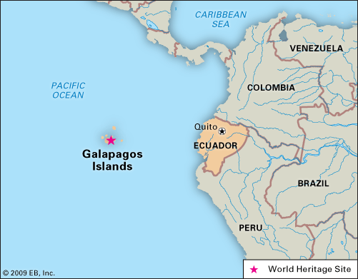


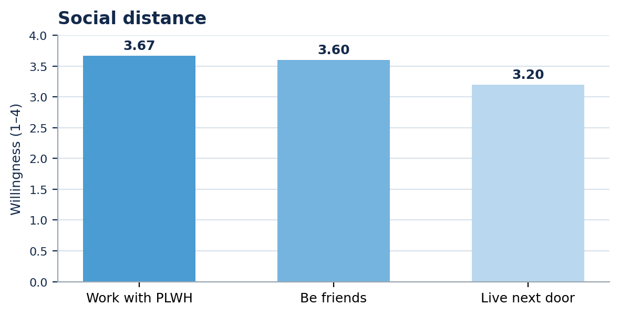



Examining HIV-Related Stigma Among Healthcare Workers (HCWs) in the Galápagos Islands, Ecuador
Grace Linares (BSN ’26), Natalia Villegas Rodriguez, PhD, MSN, RN, IBCLC, FAAN (Advisor)
HIV-related stigma in healthcare can delay testing, reduce adherence, and worsen outcomes for people living with HIV (PLWH)¹
In Ecuador, HIV remains stigmatized in care settings, and remote island communities face added privacy and workforce constraints²
The Galápagos context is unique: geographic isolation, limited specialty services, and close-knit social networks²
Little is known about healthcare worker’s related stigma in the Galápagos Islands³
DEMOGRAPHICS
CONCLUSION
  Background
FRAMEWORK
Characteristic | n | %
Gender
Women | 11 | 73.3
Men | 4 | 26.7
Country of Origin
Ecuador | 14 | 93.3
Education
≤ Bachelor’s | 7 | 46.7
≥ Master’s | 8 | 53.3
Occupation
Nurse | 5 | 33.3
Physician | 3 | 20.0
Other HCW | 7 | 46.7
• Overall low levels of overt HIV-related stigma were observed among healthcare workers
• Fear of occupational exposure remains a key concern and showed the greatest variability •. Evidence of subtle, value-based bias suggests stigma may persist in less visible ways
• HCWs generally reported high willingness to interact with PLWH, though comfort decreased with closer personal proximity
• Findings highlight that stigma is not always explicit and may influence care through implicit attitudes and perceptions
• Results emphasize the importance of addressing both knowledge gaps and underlying beliefs in stigma-reduction efforts
Drivers
(stereotypes, fear, blame)
Health Stigma &
Discrimination Framework
Manifestations
(discomfort, social distance)
STUDY CONTEXT
Mitigators
(stigma-reduction education)
IMPLICATIONS
This framework was used to examine how stigma influences
provider attitudes, behaviors, and patient care.
RESULTS
Strengthening HIV education and stigma-reduction training for HCWs is essential to address persistent fear of occupational exposure and support more confident, patient-centered care.
San Cristóbal is a remote island setting where limited anonymity may heighten confidentiality concerns.
Overall, overt HIV-related stigma was low; the clearest remaining signals were fear of occupational exposure and value-based comfort.
PURPOSE
Expanding stigma-reduction efforts in rural and remote settings, such as the Galápagos, is critical to improving access to training and reinforcing confidentiality within small, close-knit communities.
• Describe HIV-related stigma among healthcare workers on San Cristóbal Island.
• Compare patterns across stereotypes, discomfort/bias, social distance, and education exposure.
METHODS
Future research should focus on larger and more diverse samples to better understand how HIV-related stigma varies by role, training, and clinical experience, while incorporating mixed-methods approaches to capture underlying attitudes and behaviors.
Fear of contracting HIV had the highest stigma mean (2.5).
Willingness was high overall, but lowest for living next door.
STUDY DESIGN
SAMPLE
MEASURES
ANALYSIS
KEY PATTERN
Quantitative descriptive
secondary data analysis
N = 15 HCWs
Mean age = 37.7 ± 9.4 years (20–53)
73.3% women
Items based on the
Health Stigma and Discrimination Framework (HSDF) assessing:
Stereotypes/prejudice
Discomfort/bias
Social distance
Stigma-reduction education exposure
Descriptive statistics
(means, SDs,
frequencies)
LOW overt stigma
PERSISTENT fear of exposure
Acknowledgments: This research was supported by the Galapagos Science Center.
SUBTLE value-based bias
REFERENCES
World Health Organization (n.d.). HIV and AIDS. Retrieved September 29, 2025, from https://www.who.int/news-room/fact-sheets/detail/hiv-aids
Stangl, A. L., Earnshaw, V. A., Logie, C. H., van Brakel, W., Simbayi, L. C., Barré, I., & Dovidio, J. F. (2019). The Health Stigma and Discrimination Framework: A global, crosscutting framework. BMC Medicine, 17(1), 31. https://doi.org/10.1186/s12916-019-1271-3
Rodríguez, A., Romero-Sandoval, A., Sandoval, B. A., & Romero, N. (2022). Medical specialist distributions in Ecuador: A geographical and temporal analysis of data from 2000 to 2017. BMC Health Services Research, 22(1), 671. https://doi.org/10.1186/s12913-022-08056-5
Parent study conducted in Spanish on San Cristóbal using private survey administration
to reduce social desirability bias.
Approved by UNC IRB and Galápagos IRB.
73.3% reported recent stigma-reduction education
within the past year.
Recent education may support favorable attitudes, but training still needs to address emotion-driven fear and implicit preferences.
Notes:
72”w x 42”h poster (PhD Posters-$64.95) Sized for SON 6ft Roll Displays. File size is 36” w x 21” h, (IMPORTANT note for PhD Posters upon submission of poster) print at 200%; Trim leaving a white 1/2” edge around all sides of poster

