Slide 1
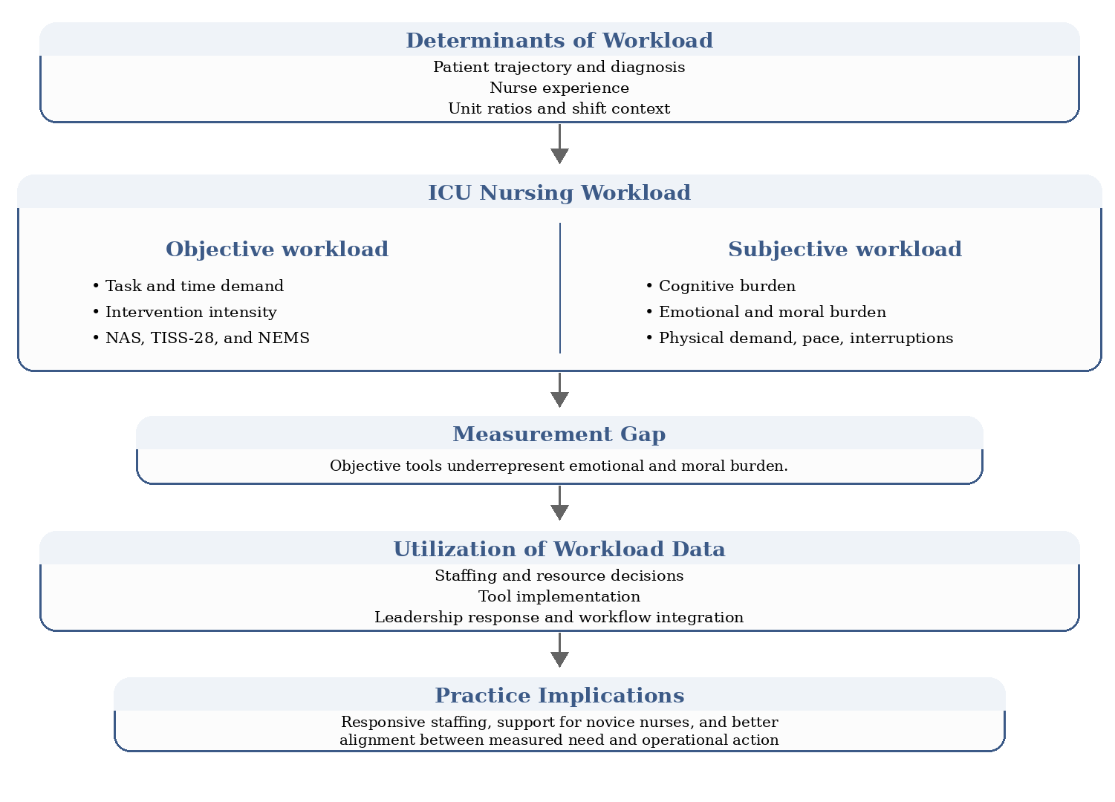
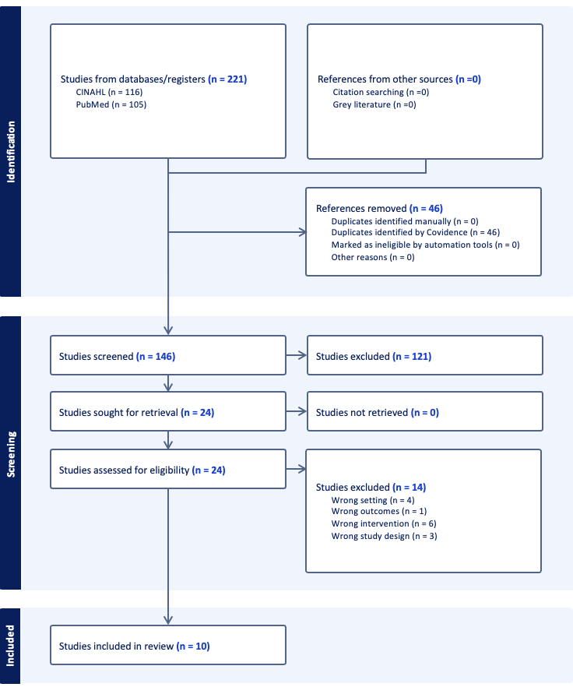
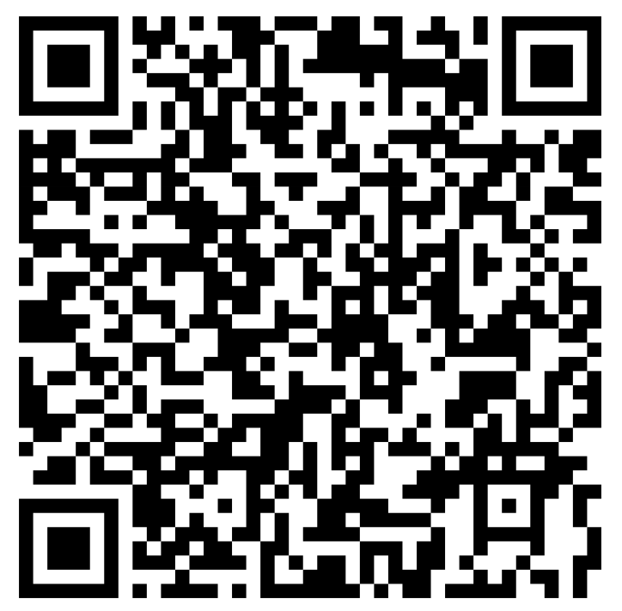
Reconceptualizing Acuity in Critical Care: Integrating Nursing Workload into Staffing and Clinical Decision-Making
LOGAN MONDAY & Nancy Jo Thompson, DNP, MSN, RN (Honors Advisor)
Introduction
Acuity-based severity scoring tools are widely used in ICUs to quantify patient acuity and guide clinical & staffing decisions (Desai & Gross, 2019; Salluh et al., 2025). These tools rely primarily on physiologic indicators to predict mortality risk and inform patient placement & resource allocation (Quintairos et al., 2023; Stretch & Shepherd, 2021).
Despite their widespread use, severity scoring tools may not full capture the complexity of nursing workload, including cognitive, emotional, and organizational demands (Carayon & Gurses, 2008; Griffiths et al., 2020).
Nursing workload is a critical determinant of patient safety, staffing adequacy, and care quality in the ICU setting (Griffiths et al., 2020)
Misalignment between measured acuity and real-time nursing workload may contribute to burnout, inefficient resource allocation, and adverse patient outcomes (Olakotan et al., 2025).
Results
Conceptualization of Nursing Workload
Nursing workload was consistently described as both objective (task-based, time-measured) and subjective (cognitive, emotional, and moral burden) with studies demonstrating these dimensions do not consistently align.
Discussion
Findings of this Review
Severity scoring tools provide objective physiologic measures of acuity but consistently fail to capture subjective dimensions of workload (cognitive, emotional, organizational), creating a gap between measured and actual nursing demand.
Nursing workload is multifactorial, shaped not only by patient acuity but also by nurse experience, shift context, patient turnover, and unit-level factors, explaining variability not reflected in standardized tools.
Objective and subjective workload do not consistently align, reinforcing that current acuity models may underestimate total nursing effort.
The Role of Severity Scoring Tools in Guiding Staffing Decisions
Severity scoring tools can support staffing by providing structured, data-driven insight into patient acuity, but their impact depends on active integration into staffing workflows rather than passive documentation.
Studies showed that when workload data were used in real-time staffing decisions, nurses reported improved staffing adequacy, resource availability, and patient assignment, whereas failure to act on data led to persistent gaps between calculated workload and actual staffing.
Differences Between Objective and Subjective Workload
Objective workload measures do not fully reflect subjective workload, which includes cognitive, emotional, and coordination demands, particularly in complex or high-stress patient situations.
Nurse experience significantly influenced perceived workload, with less experienced nurses reporting higher subjective burden despite similar objective demands, suggesting variability in workload not captured by acuity tools.
Acuity Scoring Tools and Their Relationship to Patient Safety Outcomes
Severity scoring tools were not direct predictors of patient outcomes, but influenced outcomes indirectly through staffing decisions resource allocation, and leadership response to workload data
Patient safety outcomes were shaped by a combination of workload, staffing adequacy, and workflow factors, indicating that acuity tools are most effective when integrated with clinical judgment and organizational decision-making.
Purpose And Research questions
The purpose of this integrative review was to synthesize current research on ICU nursing workload, including how workload is conceptualized, what factors influence it, and how workload data are used to inform staffing, resource allocation, and patient outcomes in adult intensive care units. The following questions guided the review:
How does the use of acuity-based severity scoring tools impact nurse-sensitive indicators (staffing, resource distribution, burnout) in adult ICUs?
How do adult ICU nurses perceive the ability of acuity-based severity scoring tools to reflect real-time, non-quantifiable patient care demands, and what impact does this have on staffing decisions, resource allocation, and burnout?
What is the relationship between acuity-based severity scoring tools and adverse patient events (falls, medication errors, infections)?
Methods
Study Design
An integrative review was conducted using PubMed and CINAHL, with search terms related to workload, staffing, acuity, severity, ICU, and nursing combined using Boolean operators (AND and OR).
Inclusion and Exclusion Criteria
LIMITATIONS
Focus limited to adult ICU settings
Variability in measurement tools across studies
Predominantly observational study designs
Limited ability to establish causation
Inclusion Criteria | Exclusion Criteria
Adult ICU Critical Care | Pediatric ICU Neonatal ICU
Patient severity, acuity, or case-mix | Physicians/non-nurse provider workload
Nurse workload (NAS, staffing, hours) | Non-peer reviewed studies published prior to 2021
Peer-reviewed studies published between 2021 and 2025
References
IMPLICATIONS
Recommendations for Practice
Acuity-based severity scoring tools should be used in combination with clinical judgment and real-time nursing workload, with leadership actively integrating workload data into staffing decisions to better align patient assignments, improve resource allocation, and support safe, high-quality care
Recommendations for Research
Future research should evaluate how integration of workload data into real-time staffing models impacts nurse-sensitive outcomes such as staffing adequacy, burnout, and patient safety, particularly, in high-acuity ICU settings
Emerging technologies such as AI-enabled ambient listening and documentation tools should be explored for their potential to reduce documentation burden, improve timeliness of workload data, and enhance decision-making in ICU staffing and care delivery
Notes:
72”w x 42”h poster (PhD Posters-$64.95) Sized for SON 6ft Roll Displays. File size is 36” w x 21” h, (IMPORTANT note for PhD Posters upon submission of poster) print at 200%; Trim leaving a white 1/2” edge around all sides of poster

