Slide 1
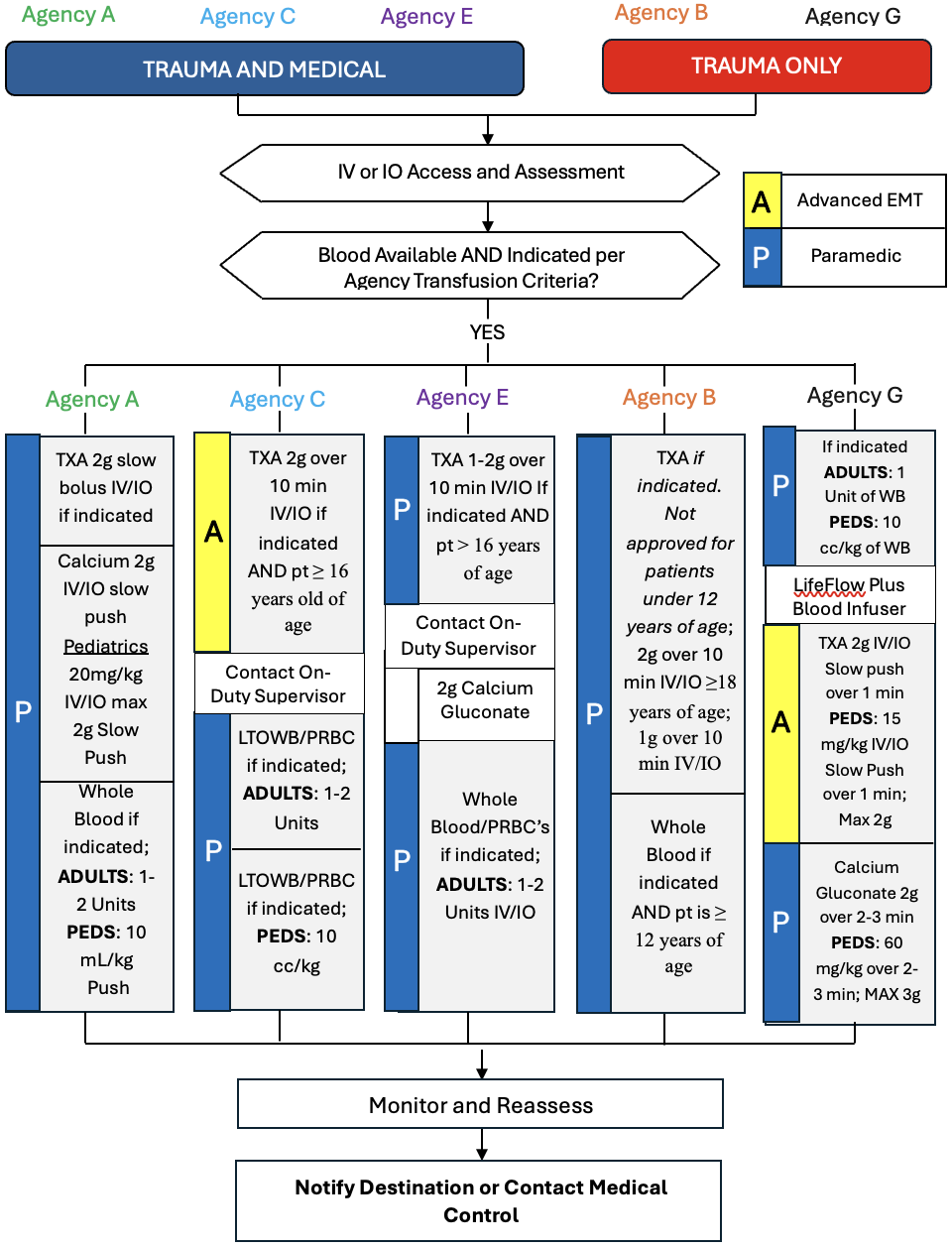



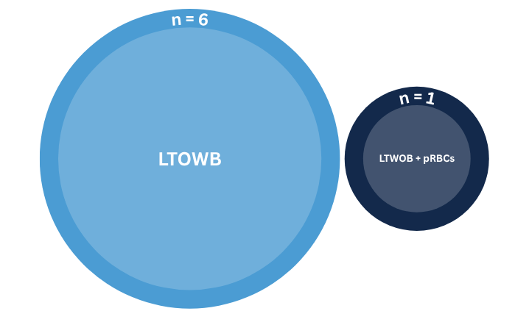
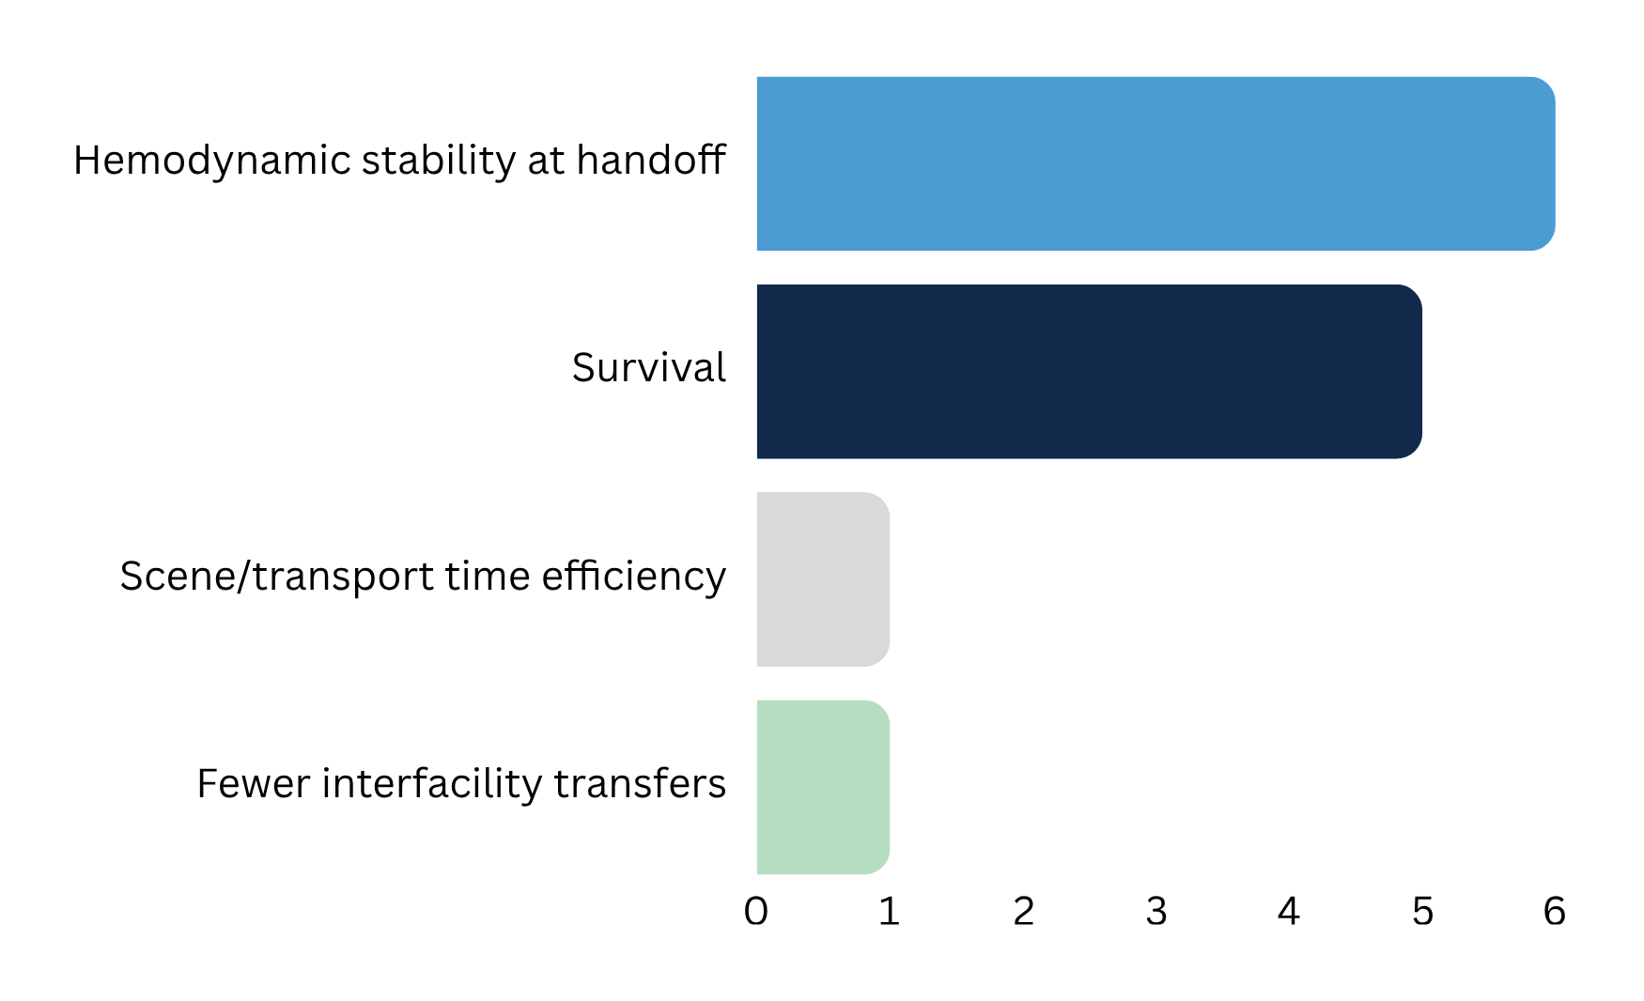


Prehospital Blood Transfusion: Evidence Synthesis and Description of North Carolina Emergency Medical Services Programs
Aranya Saengchanh, Student Nurse; Maureen J. Baker, PhD, RN, CHSE, Thesis Advisor
The University of North Carolina at Chapel Hill School of Nursing
Introduction
Results
Hemorrhage is a leading cause of preventable death and accounts for over 60,000 deaths in the United States each year (Chambers et al., 2019; Latif et al., 2023).
Earlier administration of blood products was associated with improved 24-hour and 30-day survival (Shackelford et al., 2017; Torres et al., 2024)
Between 2020 and 2023, approximately 1.2 million hemodynamically unstable trauma patients in the U.S. could have benefited from prehospital blood products. Yet, fewer than 1% received them (Carico et al., 2025).
Adoption of prehospital blood programs remains challenging because there are no standardized guidelines across EMS agencies, and use is shaped by the resources and structure of each system (Carico et al., 2025).
To date, no study has described North Carolina EMS agencies that administer blood in the prehospital setting.
Figure 1
Comparison of Blood Administration Protocol Across Agencies
Seven of eighteen agencies participated in the study, yielding a 38.9% response rate.
Improved hemodynamic stability at handoff was the most consistently reported clinical benefit across participating agencies (n = 6).
Reported barriers included financial sustainability (i.e., equipment cost, budget cuts, and funding limitations) and product sourcing and management (i.e., limited blood availability, short shelf-life, and maintaining a reliable source of blood products).
Across agencies, protocols followed a broadly similar workflow, with variation in indication criteria, adjunct medications, age cutoffs, and provider scope.
Most Common NC Program Profile
OVERALL PROGRAM APPRAISAL:
NC TRANSPORT BURDEN:
39.7 mi mean (range: 20 to 70 mi)
Mean distance to a Level I trauma center among participating agencies.
Effectiveness
Programs were rated as highly effective
Mdn = 5, range = 4 to 5, n = 6
Feasibility
Purpose
Programs were rated as very feasible
Mdn = 4.5, range = 3 to 5, n = 6
This study aims to synthesize current literature on prehospital blood transfusion and to describe the implementation of North Carolina EMS blood programs to help inform practice
Figure 2
Types of Blood Products Carried by Participating EMS Agencies
MAIN OPERATIONAL GAP
Product Unavailability
The most common reason eligible patients did not receive blood was product unavailability
Methods
PREDOMINANT PRODUCT CARRIED:
Low-Titer O Whole Blood (LTOWB)
6 agencies carried only LTOWB
1 agency carried both LTOWB and packed red blood cells (pRBCs)
Conclusion
Study Design
A descriptive cross-sectional Qualtrics survey was conducted among North Carolina EMS agencies with active prehospital blood programs.
Quantitative responses were summarized using descriptive statistics.
Qualitative data were analyzed using a thematic analysis approach to identify patterns or themes.
Sample
North Carolina EMS agencies with an established prehospital blood program at the start of data collection
Prehospital blood programs within North Carolina are feasible and perceived as highly effective but remain limited by logistical and financial barriers.
North Carolina EMS agencies shared broadly similar workflows and operational models, despite some variation in protocol details.
Figure 3
Observed Improvements Since Program Implementation
implications
MOST OBSERVED CLINICAL TREND:
Improved Hemodynamic Stability at Handoff
Reported by all agencies answering this item (n=6)
Agencies with longer transport times or those that more commonly encounter hemorrhaging patients may benefit the most from these programs.
EMS agencies should weigh the potential benefit of prehospital blood against the logistical and financial demands required to sustain it, including whether they have the infrastructure to reliably access blood when needed.
Stakeholder engagement, including partnerships with hospitals and blood banks, may help reduce costs and support blood exchange and resupply.
Prehospital blood transfusion should be integrated into existing protocols in a way that best fits the agency’s goals, regional context, and operational model.
QR CODE FOR references:
QR code for Honors Paper:
Notes:
96”w x 48”h poster. File size is 48” w x 24” h, (IMPORTANT note for PhD Posters upon submission of poster) print at 200%; Trim leaving a white 1/2” edge around all sides of poster

