Slide 1
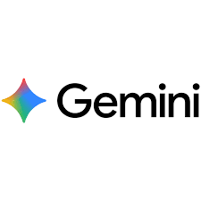
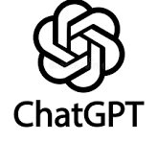

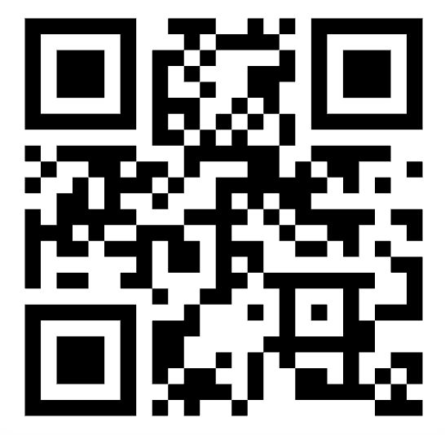

EVALUATING THE ACCURACY OF ARTIFICIAL INTELLIGENCE TO ANSWER LAYPERSONS’ QUESTIONS ABOUT HOME BLOOD PRESSURE MONITORING
Alaisha Tobias, BSN Student & Leslie L. Davis, PhD, RN, ANP-BC, FAAN, FAANP, FACC, FAHA
INTRODUCTION
RESULTS
CONCLUSIONS
Hypertension (HTN) is a major issue worldwide, affecting 1.4 billion people in 2024, making it a leading contributor to cardiovascular disease, disability, and death (World Health Organization, 2025).
In the United States, nearly half of adults (46.7%) are affected, highlighting its widespread public health impact (Khalid et al., 2024).
High blood pressure (BP) is often asymptomatic, earning the term “silent killer,” which contributes to delayed diagnosis and poor disease control.
High BP is the most modifiable risk factor, and self-care measures such as home blood pressure monitoring (HBPM) is an evidence-based strategy that improves outcomes for patients (Jones et al., 2025).
IMPACTS OF HYPERTENSION
When answering questions related to HPBM, AI platforms are generally accurate and comprehensive but not always concise, comprehensible, or fully aligned with current clinical guidelines.
AI platforms have the potential to be useful patient education tools but with important limitations
Responses often aligned with clinical guidelines, but inaccuracies were noted when addressing recently updated recommendations
Results reflects a challenge with using AI in context of rapidly evolving field of healthcare, where clinical evidence and guidelines are constantly changing
BACKGROUND
Responses were often lengthy and complex, limiting their usefulness for laypersons
Higher reading levels and technical language may reduce accessibility, particularly for individuals with lower health literacy
Inaccuracies noted in responses regarding updated BP categories and guidance on when to seek care highlight risks in clinical decision-making
Failure to clearly distinguish between conditions requiring urgent vs routine care may cause lead to delayed care or overutilization of healthcare resources
The 2025 American Heart Association/American College of Cardiology (AHA/ACC) Guideline for the Prevention, Detection, Evaluation, and Management of High Blood Pressure in Adults provides updated recommendations for BP management, and is the first major update since 2017.⁴
HBPM is a Class 1A recommendation, as it provides a reliable method for assessing BP and is a better predictor of cardiovascular outcomes than office readings (Jones et al, 2025).
Despite benefits, HBPM is underutilized and frequently performed incorrectly, limiting its usefulness. This strategy requires accurate patient education and proper technique to be effective.
In recent years, laypersons have increasingly turned to Artificial Intelligence (AI) platforms such as ChatGPT and Google Gemini for health information.
Responses demonstrated high correctness (accuracy) and comprehensiveness
Complete and detailed responses were produced for most questions
Performance was consistent across platforms; no major differences between free vs. paid tools
Results align with previous research investigating AI responses to laypersons' medical questions.
CORRECT
CONCISE
RESEARCH QUESTION
Average Mean Score: 4.14
Highest: Google Gemini (M = 4.50)
Lowest: ChatGPT Plus (M = 3.92)
Average Mean Score: 3.47
Highest: ChatGPT & Google Gemini (M=3.50)
Lowest: ChatGPT Plus (M = 3.42)
In adults with or at risk for high BP (Population), how do AI-generated responses to layperson questions about HBPM (Intervention), compared to established clinical guidelines (Comparison), measure in terms of correctness, conciseness, comprehensiveness, and comprehensibility (Outcomes)?
Most responses accurate; minor inaccuracies
75% Google Gemini responses scored 5/5
Common inaccuracies included recommending cuffless devices & using incorrect terminology (e.g., hypertensive crisis vs. emergency)
Lowest performing category
Several lengthy responses; could shorten
About half included additional tables, images, and external links
High comprehensiveness contributed to reduced conciseness
AI platforms may serve as an accessible tool to support patient learning and self-care, but they should be viewed as a supplementary resource that supports, rather than replaces, guidance from healthcare professionals.
METHODS
IMPLICATIONS
Study Design
Quantitative exploratory descriptive study
Evaluated how AI platforms respond to HBPM questions
Responses were scored using the 4 C’s Model (Lautrup et al., 2023).
Measures correctness, conciseness, comprehensiveness, and comprehensibility
Each category was scored using a 5-point Likert scale
Readability assessed using Flesch-Kincaid Grade Level Score (FKGL)
IRB exempt (non-human subjects)
Sample
12 questions developed by the student investigator and thesis advisor based on the 2025 AHA/ACC guidelines
Each question was input into 3 AI platforms:
1. ChatGPT (Free) 2. ChatGPT Plus ($20/month subscription)
3. Google Gemini (Free)
Data analysis
36 total responses were generated and evaluated separately by the student investigator and thesis advisor.
4C’s Model and FKGL scores were assigned to each response. Discussion occurred until consensus regarding scoring was met. Scores were then reported as means (M) and standard deviations (SD).
COMPREHENSIVE
COMPREHENSIBILE
NURSING EDUCATION
As lifelong learners, nurses must stay abreast of current guidelines to recognize & address any misinformation AI or other online resources may provide
Average Mean Score: 4.92
Highest: ChatGPT & Google Gemini (M=5)
Lowest: ChatGPT Plus (M = 4.75)
Average Mean Score: 3.92
Highest: ChatGPT (M=4.08)
Lowest: Google Gemini (M = 3.75)
Highest performing category
92% of responses across platforms received a perfect score of 5
Responses consistently addressed all aspects of the question, even the more esoteric ones
Second-lowest performing category
Generally clear answers that could be clarified and/or simplified
Many responses used technical terminology that might not be easily understood by laypersons
NURSING PRACTICE
Nurses must verify and clarify AI-generated health information to ensure safe and accurate HBPM and other self-care practices
NURSING RESEARCH
Future research should continue to evaluate AI as a patient education tool to guide future development of tools that better support laypersons understanding and self-care practices.
READABILITY
Average Grade Level: 6th-7th Grade
Highest: Google Gemini (M=7.31)
Lowest: ChatGPT Plus (M = 6.47)
REFERENCES
12 HBPM questions developed
related to BP categories, device selection, patient preparation, positioning, measurement frequency, and guidance on when to contact a clinician.
Responses ranged from 3rd to 10th grade level
Some responses exceeded the recommended < 6th grade level (Wasir et al., 2023)
Higher readability scores linked to longer and more complex responses
Questions were entered into ChatGPT, ChatGPT Plus ($), & Google Gemini, and responses were collected.
Student investigator and thesis advisor independently evaluated responses using 4 C’s criteria
Data analyzed using descriptive statistics (M± SD)
This project was supported by the Honors Undergraduate Research Fund administered by Honors Carolina.
Notes:
72”w x 42”h poster (PhD Posters-$64.95) Sized for SON 6ft Roll Displays. File size is 36” w x 21” h, (IMPORTANT note for PhD Posters upon submission of poster) print at 200%; Trim leaving a white 1/2” edge around all sides of poster

