Slide 1


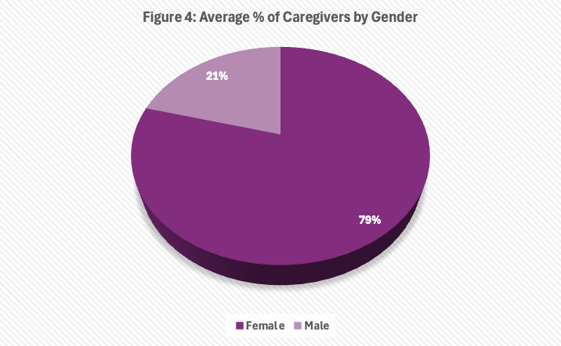
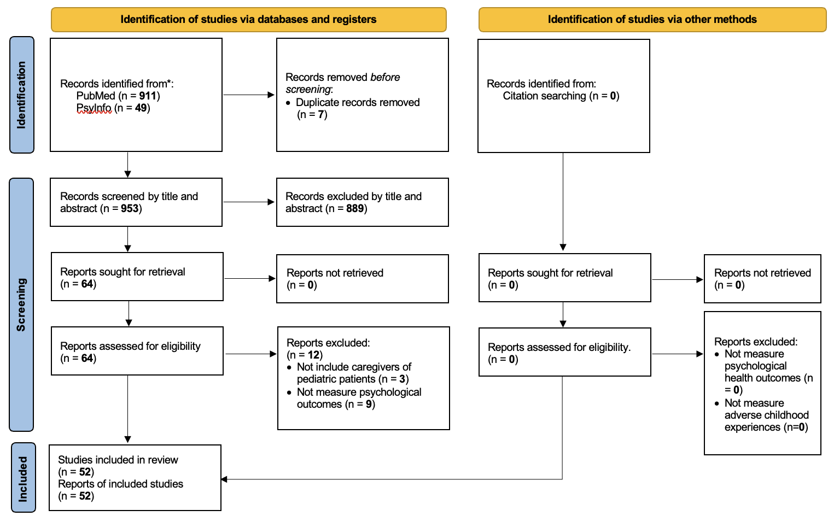


Nonpharmacological Interventions for Caregivers of Pediatric Patients: A Systematic Review
Katherine Yu¹, Student Nurse; Ya-Ke Wu^{1,2}, PhD, MSN, RN
¹The University of North Carolina at Chapel Hill, School of Nursing
²The University of North Carolina at Chapel Hill, Department of Psychiatry
,
Introduction
Conclusions
Caregivers are at a higher risk for adverse mental health outcomes, as the demands of caregiving lead to parents feeling overwhelmed by their responsibilities (Soh et al., 2025)
Forty nine percent of caregivers face chronic depression and have low self-esteem; however, parents of pediatric patients encounter more significant challenges than those caring for adults because children with illnesses struggle to progress to the next developmental milestone (Piran et al., 2017; Woodgate et al., 2015)
Caregivers of children with complex medical conditions have self-reported feeling tired, anxious, and face social isolation due to the responsibilities of providing continuous care and managing other family and household tasks (Hirt et al., 2023)
The purpose of this review was to synthesize current literature the focuses on nonpharmacological interventions for caregivers of pediatric patients with chronic and complex illness and their impacts on psychological outcomes
Figure 3: Psychological Outcomes Measured Across Studies
Most studies in our review found that the interventions were successful at reducing psychological effects such as stress, anxiety, depression, PTSD, quality of life, ways of coping, resilience, and burden
However, it is recommended that additional research is conducted on interventions for reducing caregiver burden in pediatric patients that contain larger sample sizes, extended follow-up periods, and beyond the hospital setting.
Future research should investigate interventions that incorporate pharmacological therapies, test interventions outside of the hospital setting, and compare the psychological outcomes in male versus female caregivers.
Image retrieved from Canva
Figure 2: Number of Studies Included in Each Intervention
Image retrieved from Google Images
https://www.shutterstock.com/search/caregiver-child?image_type=vector
METHODS
Results
Study Design:
A systematic review was conducted to examine nonpharmacological interventions implemented on caregivers of pediatric patients.
Database:
PubMed and PsycINFO electronic databases were used to identify studies published from 2022 through 2025. Reference lists of collected studies were searched for additional eligible studies.
Inclusion Criteria:
Randomized controlled trials and quasi-experimental studies that 1) evaluated interventions aimed at reducing burden among adult caregivers of pediatric patients requiring hospitalization or post-discharge support and 2) assessed psychological outcomes
Exclusion Criteria:
Articles only presenting study protocols, qualitative studies, review articles, present expert opinions, dissertation or thesis, and studies lacking full-text availability in English
Quality appraisal:
A quality appraisal of the included studies was conducted following the Joanna Briggs Institute Systematic Reviews Tool (sum score range from 0 to 9, a higher sum score indicate a good overall quality).
Fifty-one studies met the eligibility criteria, comprising of 47 randomized controlled trials and 4 quasi-experimental studies. A total of 7,330 participants were included, representing parents, mothers, and other primary caregivers.
The average percentage of female caregivers was 78.89, and the average percentage of male caregivers was 20.27 (Figure 4).
Most of the studies were conducted in China (11 studies) or Iran (9 studies).
Most of the studies were randomized controlled trials (47 studies) or quasi-experimental studies (4 studies).
The mean quality assessment score of the 47 randomized controlled trials was 7.90 (Standard deviation [SD] ± 2.17, range = 4 to 13), and the mean quality assessment score among the 4 quasi-experimental studies was 7.5 (SD ± 0.5, range = 7 to 8).
We identified seven types of interventions: 1) Web and digital-based interventions, 2) therapeutic interventions, 3) cognitive behavioral interventions, 4) family-integrated interventions, 5) educational interventions, 6) mindfulness-based interventions, and 7) resilience training interventions (Figure 2).
The length of the intervention programs ranged from 1 day (e.g., 1 daily session) to 12 months (Table 1).
The types of psychological outcomes measured were anxiety, caregiver burden, cortisol levels, depression, distress, family, caregiver task, inventory, family function, insomnia, post traumatic stress disorder (PTSD), quality of life, resilience, self-efficacy, well-being, and ways of coping (Figure 3).
Overall, nonpharmacological interventions implemented for caregivers of pediatric patients improved psychological outcomes.
Figure 1: Flowchart of the inclusion procedure in a PRISMA diagram
References
Reference list:
Table 1. Summary of included studies:
Notes:
72”w x 42”h poster (PhD Posters-$64.95) Sized for SON 6ft Roll Displays. File size is 36” w x 21” h, (IMPORTANT note for PhD Posters upon submission of poster) print at 200%; Trim leaving a white 1/2” edge around all sides of poster

