Slide 1
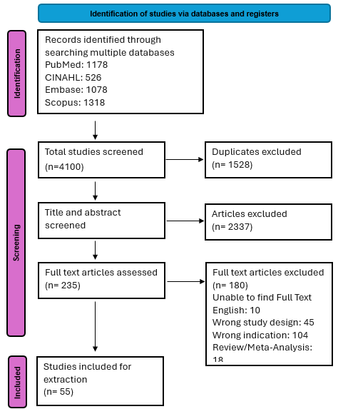

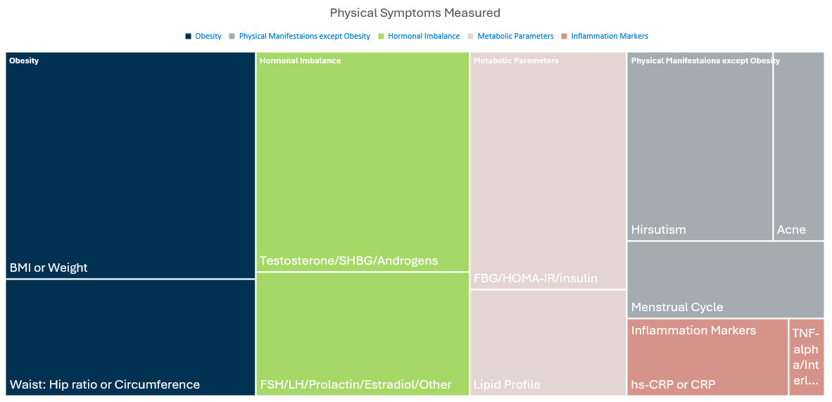
Effective Interventions for Improving Mental Health Concerns and Pathophysiological Symptoms of Women with Polycystic Ovarian Syndrome
Poster Title
Priya desai, aBSN Student
advisors: nicole forlan, dnp, WHNP-BC, IBCLC & suja davis phd, rn, cgrn, cgnc
  INTRODUCTION
  Polycystic Ovarian Syndrome (PCOS) is a complex endocrine disorder characterized by menstrual dysfunction, anovulation, and polycystic ovaries, affecting women of reproductive age.
  Clinical management of PCOS has largely focused on physiological symptoms, often overlooking the mental health factors. Previous reviews have not comprehensively examined the effectiveness of pharmacological and non-pharmacological interventions in addressing both the physical and mental health aspects of PCOS.
exclusion criteria
Studies on personality disorders, neurodevelopmental disorders, psychotic disorders, sleep-wake disorders, substance use disorders, trauma associated disorders, and neurocognitive disorders
Studies that focus on any aspects of quality of life with no measurable mental health component such as depression, anxiety, or body image scores.
Articles not published in English and conference abstracts, review articles, and letters to the editor.
  Data extraction
  Study details, participant characteristics, type of intervention, mental health conditions studied, physical symptoms studied, and outcomes of the intervention
  Background
  PCOS affects 10-13% of reproductive aged women, the pathophysiology and possible genetic components are not strongly understood.
  Mental health concerns such as depression, anxiety, and eating disorders have a higher prevalence in women with PCOS.
  Physical symptoms can vary widely from hormonal imbalances, metabolic disturbances, obesity, and other physical manifestations such as acne, hirsutism, androgenic alopecia, menstrual cycle irregularities.
  Mental health conditions are treated separately from physical symptoms, thus highlighting the importance of evaluating mental health outcomes alongside physical health outcomes in PCOS intervention studies.
  Results
  Interventions and metabolic parameters of pcos
Insulin sensitizing agents such as metformin and pioglitazone significantly reduced insulin resistance markers.
Metabolic parameters were not widely measured for lifestyle modification interventions. However, findings from two RCTs indicate that diet and aerobic exercise can improve insulin resistance.
Outcomes from studies administering melatonin, herbal supplements, omega-3 fatty acids, vitamin E, vitamin D, and myoinositol, suggest that Nutritional interventions can improve metabolic parameters.
  Interventions and mental health associated with pcos
Despite wide variations in interventions anxiety and depression scores generally decreased significantly across all studies post-intervention.
Nutritional interventions did not address body image or binge eating disorders. However, findings indicate that cognitive behavioral therapy and lifestyle modifications can improve binge eating and body image.
Multimodal interventions incorporating lifestyle modifications, cognitive behavioral therapy, and weekly feedback can improve body image.
  Interventions and hormonal imbalance and inflammation markers of pcos
Pharmacological interventions and Nutritional interventions such as Pioglitazone, omega-3 fatty acids with vitamin D, and coenzyme Q 10, significantly improved inflammation markers.
Findings from studies implementing Nutritional interventions, specifically carnitine with chromium, probiotics with selenium, omega-3 fatty acids with vitamin D, and coenzyme Q 10, suggest positive outcomes for reducing testosterone.
Overall, exercise-based interventions and dietary interventions demonstrated limited effects on hormonal balance. However, results from one RCT indicate that aerobic exercise can improve free androgen index.
  Purpose
  To map the current interventions that simultaneously address both physiological and mental health outcomes among individuals aged 18 to 50 years diagnosed with PCOS.
  Interventions and physical manifestations of pcos
Obesity was the most measured physical manifestation of PCOS. Body mass index (BMI) and weight significantly decreased with interventions consisting of cognitive behavioral therapy, lifestyle modifications, and multimodal approaches.
Findings on the effectiveness of pharmaceutical interventions, specifically insulin sensitizing agents (ISA) depended on the length of time the interventions were implemented. Outcomes from ISAs used for three months compared to six months, did not indicate significant reduction in weight or BMI.
Findings from multimodal intervention studies that compared lifestyle modifications or ISA interventions as a control did not indicate one intervention significantly improved weight or BMI more than another.
Evidence from multimodal interventions suggests obesity, weight, waist, and hip circumferences can be reduced through consistent monitoring, lifestyle modifications, and counseling.
Findings from two RCTs administering laser hair removal suggests laser hair removal is effective in reducing hirsutism, depression, and anxiety.
  MeThods
  Study design
  Database search of PubMed, CINAHL, SCOPUS, and EMBASE for research studies that met our inclusion and exclusion criteria resulted in 55 studies to review. See PRISMA diagram.
Inclusion criteria
Experimental, quasi‑experimental, analytical observational, and descriptive observational studies on PCOS and mental health including depression, anxiety, eating disorders, or body dysmorphia.
Pharmacological or non-pharmacological interventions
Outcomes measured for at least one physical and one mental health symptoms.
  Implications
There is a need for further research that measures outcomes of multiple physical symptoms simultaneously as well as mental health conditions among women with PCOS.
GLP-1s have not yet been extensively studied in women with PCOS and is another avenue of research for its effect on mental health and physical symptoms.
Notes:
96”w x 48”h poster. File size is 48” w x 24” h, (IMPORTANT note for PhD Posters upon submission of poster) print at 200%; Trim leaving a white 1/2” edge around all sides of poster

Slide 2
Author’s Name
  Introduction
  Do nurses who report having adequate coping mechanisms also report fewer depressive symptoms using the Zung Self-Rating Depression Scale?
  Results
  Do nurses who report having adequate coping mechanisms also report fewer depressive symptoms using the Zung Self-Rating Depression Scale?
  Result Section Heads
  Do nurses who report having adequate coping mechanisms also report fewer depressive symptoms using the Zung Self-Rating Depression Scale?
  Conclusions
  Do nurses who report having adequate coping mechanisms also report fewer depressive symptoms using the Zung Self-Rating Depression Scale?
  Background
  Do nurses who report having adequate coping mechanisms also report fewer depressive symptoms using the Zung Self-Rating Depression Scale?
  Implications
  Do nurses who report having adequate coping mechanisms also report fewer depressive symptoms using the Zung Self-Rating Depression Scale?
  Purpose
  Do nurses who report having adequate coping mechanisms also report fewer depressive symptoms using the Zung Self-Rating Depression Scale?
  MeThods
  Study Design
  Do nurses who report having adequate coping mechanisms also report fewer depressive symptoms using the Zung Self-Rating Depression Scale?
  Sample
  Do nurses who report having adequate coping mechanisms also report fewer
  Other Section Heads
  Do nurses who report having adequate coping mechanisms

