Slide 1
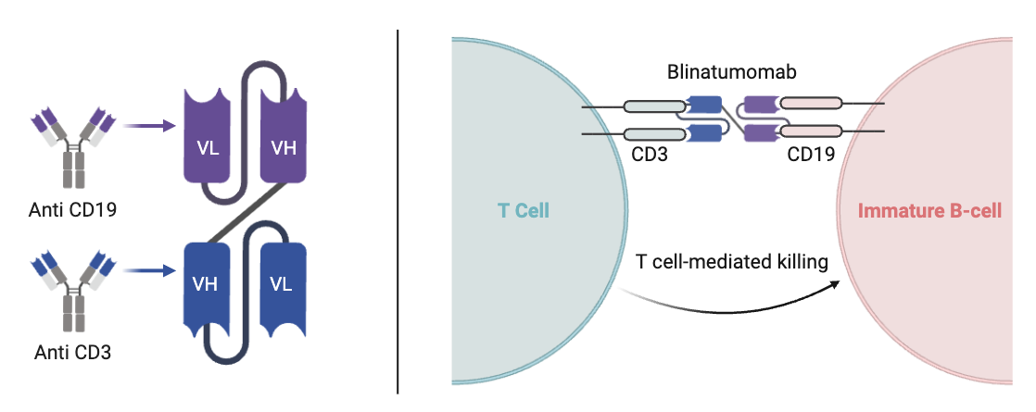

Understanding Adolescent and Young Adult Perspectives on Blinatumomab Therapy through Public Social Media Content
Uma Nair¹ and Sheila Santacroce^{1,2}
The University of North Carolina at Chapel Hill School of Nursing¹, Lineberger Comprehensive Cancer Center²
  Background
  Results
  Chemotherapy regimens to treat B-cell acute lymphoblastic leukemia (B-ALL) cause debilitating symptoms. Chemotherapy backbones during consolidation have been replaced with blinatumomab (blina), a bispecific T-cell engager that facilitates death of malignant B-cells (see figure).
  Blina is administered as 28-day continuous infusions controlled by pump via venous access device, first during 3-day hospital stays for close monitoring then outpatient.
  Navigating cancer during developmental transitions can be disruptive, for adolescents and young adults (AYA), who are susceptible to setbacks given challenges to independence when autonomy is meant to blossom.
Recurrent Themes
Social Support
A Mixed Bag
Device Concerns
Positive Reframing
Positives
Coping with Humor
Negatives
Side Effects
Familial Support
Blina Awareness
Peer Support
Disappointment in Blina Equipment
Disruption of Normalcy
  Methods
  Analytic sample included 11 posts by N=6 TikTok posters. Eligible posters:
  (a) self-identified as having B-ALL,
  (b) appeared to be AYA
  (c) used English in the video, and
  (d) reported personal experiences with blina.
  Excluded were posts by caregivers, reposted videos or promotional material, and videos restricted by account settings.
Developmental Stage | Potential Challenges
Adolescence and Emerging Young Adulthood (AYA) | Concerns related to independence, body image, physical appearance, peer acceptance, sexuality Loss of control and forced dependence School absence Disrupted plans and sense of future self
  Conclusion
  Implications
  While 28-day infusions require adaptation, side effects are minimal and outpatient status support maintain normalcy
  Better understanding of AYA experience can inform individualized and wholistic nursing care
  Nurses should counsel AYAs with new B-ALL diagnoses to risks involved in sharing personal health information via social media
Sample
Poster | Age | Gender | Post # | Date Posted
A | 18 | Female | 1 | 3/31/25
 |  |  | 2 | 4/24/25
 |  |  | 3 | 4/1/25
B | 18 | Male | 1 | 4/30/25
C | 22 | Female | 1 | 9/23/25
 |  |  | 2 | 9/23/25
D | 21 | Female | 1 | 5/21/25
E | 24 | Female | 1 | 3/11/22
 |  |  | 2 | 11/17/23
 |  |  | 3 | 2/10/24
F | 20 | Female | 1 | 3/27/25
  Nurses should develop sensitivity to dark humor as healthy coping mechanism for AYA
  Social media provides platforms for sharing life’s best parts. AYAs use platforms such as TikTok to share parts of their cancer and display expertise regarding their health condition and its treatment. Analyzing what AYAs say on TikTok through public posts can address gaps in understanding how AYA cope with Blina and other novel approaches to cancer therapy.
  Blina offers opportunities for AYA to achieve developmental tasks, for example, assume responsibility for infusion monitoring and driving themselves to clinical appointments
  Social media use in research is valuable in cost-effective ways to amplify patient voices
  AYAs have rich perspectives and diverse opinions which should not be overshadowed by those of children and older adults
  AYAs find opportunities for self-expression amid blina therapy such as using humor and designing personalized bags for carrying pumps, extra batteries, and infusions
  Purpose:
  Amplify voices of AYA about their experiences with blina
  Contact Information
  umanairr13@gmail.com
  santacro@email.unc.edu
  References
  QR
  CODE
Notes:
4x3 aspect ratio poster File size is 28” w x 21” h

