Slide 1

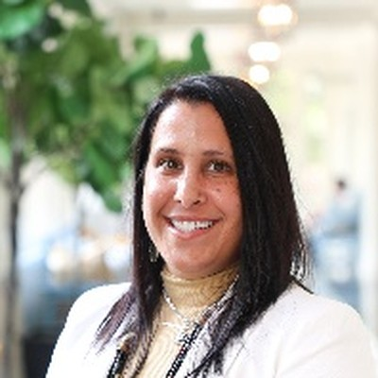
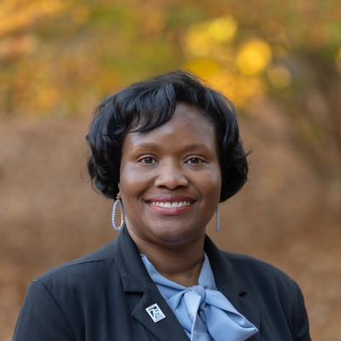
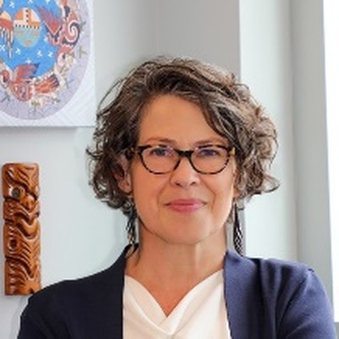
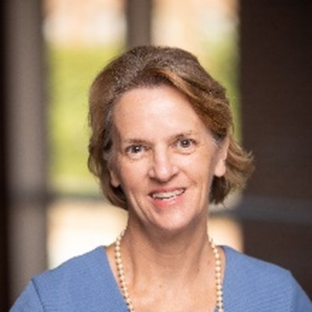
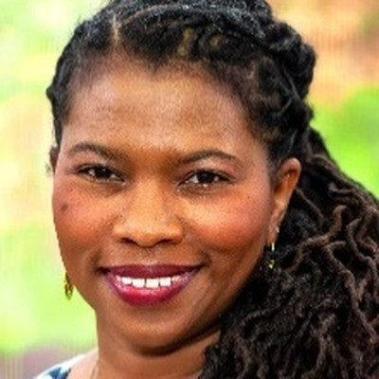
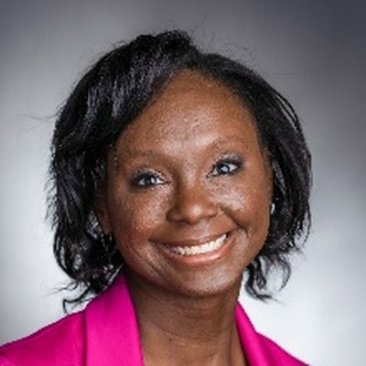
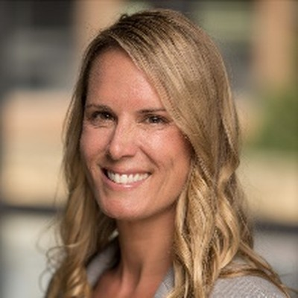
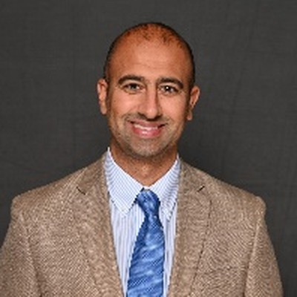
PhD Research Advisors
Advancing Nursing Science Together
Our faculty are discovering innovative solutions to the world's most challenging health care problems. As a PhD student, you will collaborate with leading nurse scientists whose work advances our five areas of excellence: Community Engagement, Multilevel Determinants of Health, Nursing and Health Systems, Preventing Chronic Illness and Promoting Health, and Digital Innovation. Use this guide to explore faculty research interests and identify potential mentors who align with your goals.
Jada L. Brooks
PhD, MSPH, RN, FAAN – PhD Program Director & Associate Professor
Ashley Leak Bryant
PhD, RN, OCN, FAAN, FGSA – Professor; Senior Associate Dean, Strategy & Global Affairs
Focus Health disparities, environmental health, cardiovascular disease, mindfulness–based stress reduction
Focus Older adults, blood cancer palliative and supportive care interventions, interprofessional collaboration, building workforce capacity
Lorinda A. Coombs
PhD, MSN, FNP-BC, AOCNP – Assistant Professor
Leslie L. Davis
PhD, ANP-BC, FAAN, FAANP, FACC, FAHA, FPCNA – Associate Professor
Focus Oncology nursing and patient-centered outcomes in geriatric oncology; supportive care and quality of life for older adults with advanced cancer; advanced practice roles in the oncology workforce; mixed methods research
Focus Developing and testing digital health interventions to promote self-care for those with cardiovascular and other acute and chronic conditions
Cheryl L. Woods Giscombe
PhD, PMHNP-BC, RN, FAAN, FABMR – Distinguished Term Professor; Chief Wellness Officer
Tamryn Fowler Gray
PhD, RN, MSN, MPH – Assistant Professor
Focus Biopsychosocial mechanisms of stress and coping on chronic illness; tailored mindfulness and community-engaged interventions; integrative health; health professions well-being; Superwoman Schema and cardiometabolic health
Focus Family caregiving, palliative care, data science, social epidemiology, cancer and aging outcomes, and care transitions for caregivers of adults with serious illness
Rachel Hirschey
PhD, RN, FAAN – Associate Professor
Saif Khairat
PhD, MPH – Professor and Beerstecher-Blackwell Distinguished Scholar; Chief Artificial Intelligence Officer and Vice Provost for AI
Focus Advancing cancer prevention, control, and survivorship through community-engaged intervention development and implementation science
Focus The application of digital health and AI to improve health outcomes

Slide 2
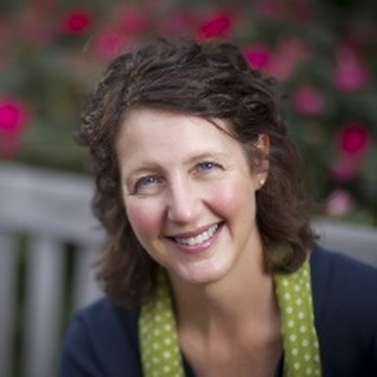
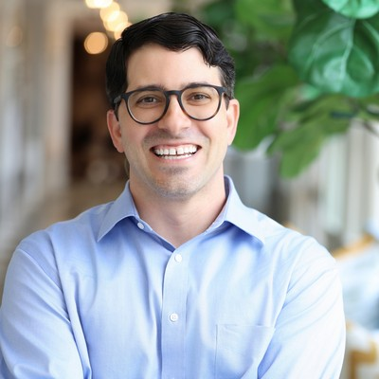
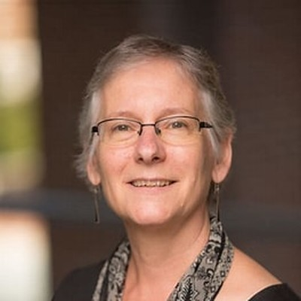
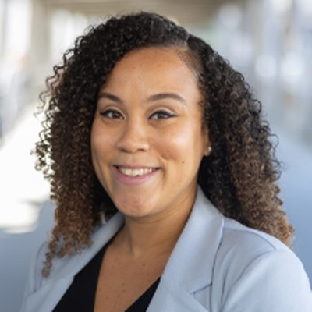
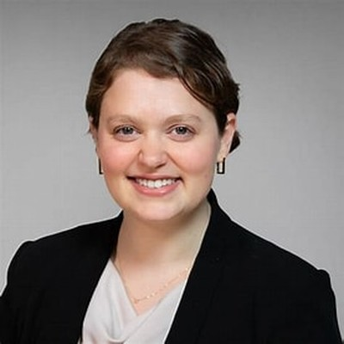
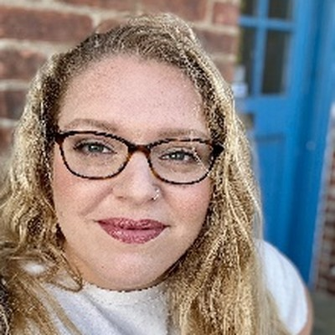
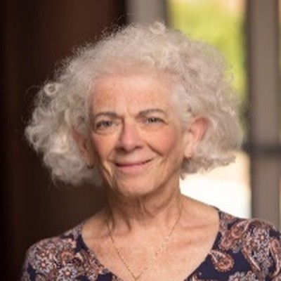
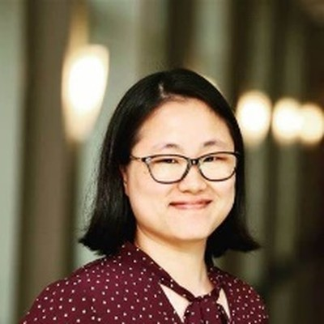
PhD Research Advisors
Advancing Nursing Science Together
Shawn Kneipp
PhD, ANP, PHNA-BC – Sarah Frances Russell Distinguished Term Professor
Matthew LeBlanc
PhD, RN – Assistant Professor
Focus Social, policy, and economic determinants of health in disadvantaged populations; welfare policy, employment, and women's health; chronic disease prevention and self-management among lower-wage workers; public health nursing interventions
Focus Cancer care quality and equity in multiple myeloma and other hematologic malignancies; diagnostic pathways, treatment access, and survivorship; patient-reported outcomes; mixed methods research
Jennifer Leeman
DrPH, MDiv, MPH – Jane Sox Monroe Distinguished Professor
Lisa Mansfield
PhD, RN – Assistant Professor
Focus Implementation science, with a focus on interventions for birthing persons or older adults and their caregivers
Focus Health disparities and equity, minority health, cancer prevention and screening, social determinants of health, women's health, vaccine behaviors and decision-making
Isabel Roth
DrPH, MS – Assistant Professor
Rebecca (Becky) E. Salomon
PhD, RN, PMHNP-BC – Assistant Professor
Focus Implementing integrative health and mindfulness-based interventions in primary care and hospital settings for patients with chronic conditions; methods focus on implementation science, community-engagement, and mixed-methods
Focus Biobehavioral mechanisms linking multilevel determinants of health to psychoneurological symptoms and functional outcomes in mothers, with a growing emphasis on systems dynamics modeling
Sheila Judge Santacroce
PhD, RN, CPNP, FAAN – Carol A. Beerstecher-Blackwell Distinguished Professor
Jihye Kim Scroggins
PhD, RN – Assistant Professor
Focus Psychosocial stress (healthcare costs, unmet basic needs) in serious illness such as pediatric cancer, and how responses to these stressors affect outcomes for patients and families
Focus Maternal-infant health, maternal morbidity and mortality, symptom science, mental health, social determinants of health, data science, informatics, secondary data analysis

Slide 3
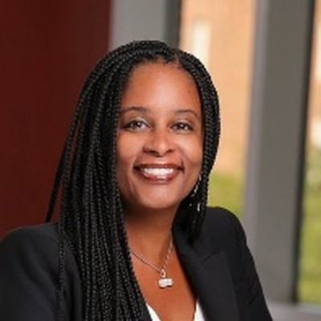
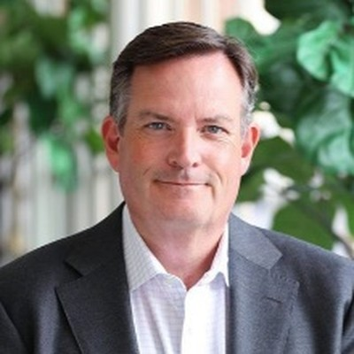
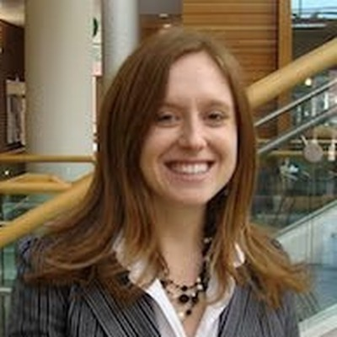
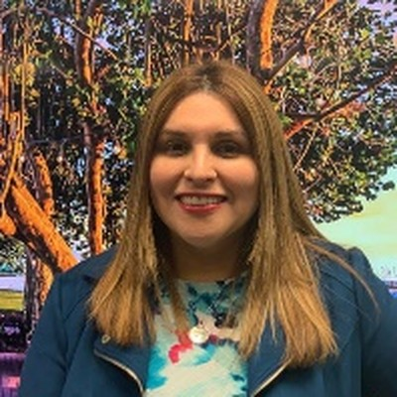
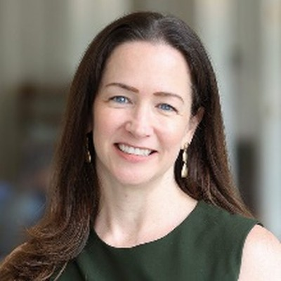
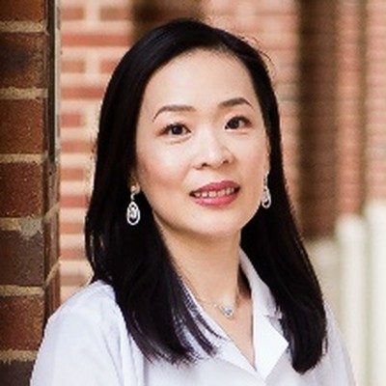
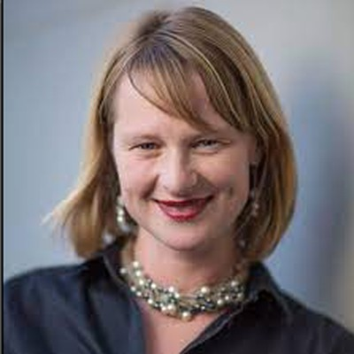
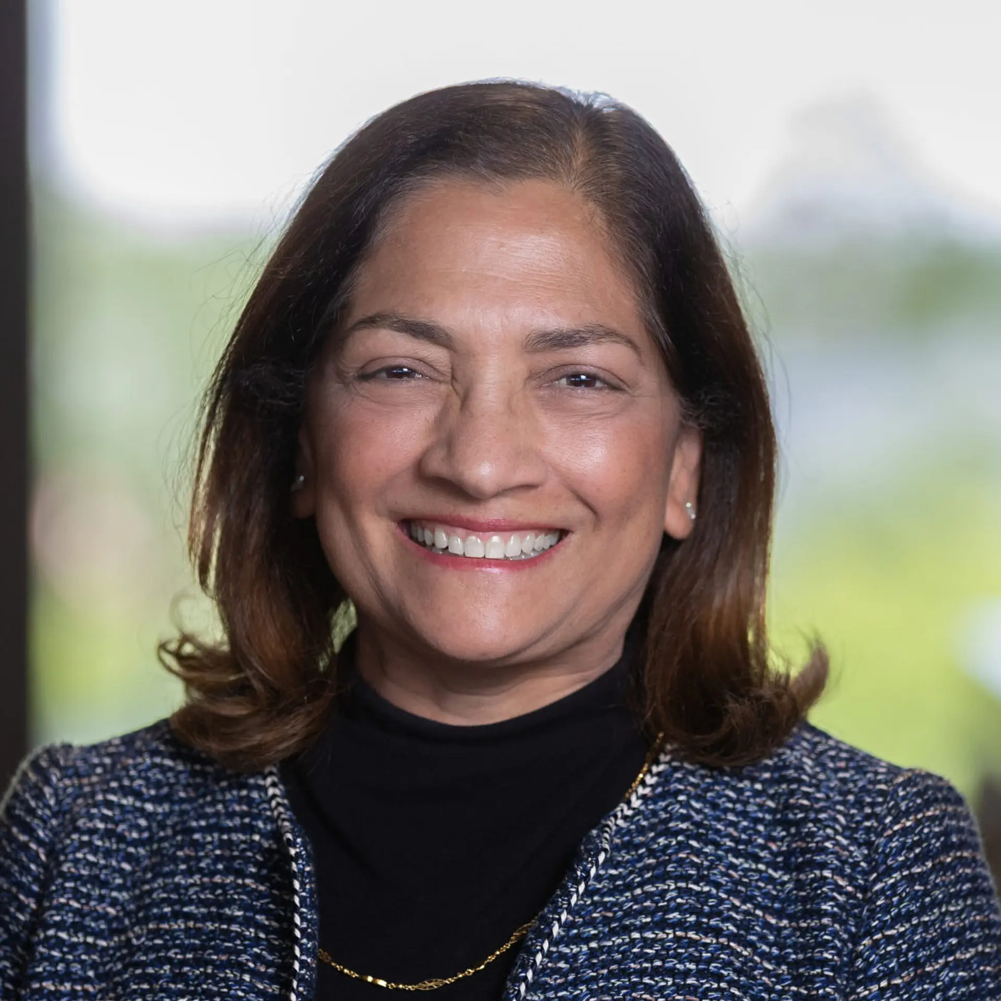
PhD Research Advisors
Advancing Nursing Science Together
Karen Sheffield-Abdullah
PhD, RN, CNM, FACNM – Assistant Professor
Brent J. Small
PhD – Senior Associate Dean for Research & Frances Hill Fox Distinguished Professor
Focus Perinatal mental health, health equity, integrative health approaches, mindfulness, trauma-responsive care, mixed and qualitative methods
Focus Quality of life among cancer survivors, cancer-related cognitive impairment, longitudinal statistical methods
Kea Turner
PhD, MPH, MA – Associate Professor
Natalia Villegas Rodriguez
PhD, MSN, RN, IBCLC, FAAN – Associate Professor
Focus Cancer survivorship, cancer care delivery, and implementation science
Focus Women's health, STI and HIV prevention, breastfeeding, and the use of technology for prevention, particularly among Latino/a populations
Jessica R. Williams
PhD, MPH, PHNA-BC, FAAN – Assistant Dean, PhD Program; Associate Professor
Ya-Ke “Grace” Wu
PhD, RN – Assistant Professor; Director, Biobehavioral Laboratory
Focus Intimate partner violence, trauma-informed care, health system responses, and long-term health consequences of violence including chronic pain, HIV, and substance use
Focus How stress-related biological and psychological pathways, appetite regulation, and immune-inflammatory processes contribute to disordered eating, psychiatric health, obesity, and cardiometabolic outcomes
Jessica Zegre-Hemsey
PhD, RN, FAHA – Associate Professor
Bharathi Zvara
PhD, MS – Associate Professor
Focus Emergency cardiac care; non-invasive cardiac monitoring for early disease detection, prediction, and response; early triage; risk stratification and access to care for improved patient outcomes; and innovation and technology in cardiovascular systems of care
Focus Intergenerational effects of childhood maltreatment and adversity. Biopsychosocial mechanisms linking early adversity to parent and child health and development. Developmental and life course perspectives. Longitudinal, observational, and population health research methods

